Slide 1
Hotel_Booking_Cancellation_Prediction
Himanshi Sharma
Sreyashi Basak
Anusha
Bhaswati Banerjee
5. Mithun
6. Sivakumar S
7. Susovan Das

Slide 2
HOTEL_BOOKING_CANCELLATION_PREDICTION

Slide 3
The supervised classification business problem has been addressed using various machine learning and deep learning models, including Logistic Regression, Decision Tree, Random Forest, XGBoostClassifier, and Artificial Neural Networks.
This project encompasses:
- Data Analysis with Pandas and NumPy
- Data Visualization utilizing Seaborn, Matplotlib, and Tableau
- Data Collection from Kaggle
- Feature Engineering
- Handling Null Values
- Treating Outliers in Variables
- Conducting Statistical Tests
- Building Models and Comparing Performance

Slide 4
Problem Statement
Booking cancellations significantly impact demand management decisions in the hospitality industry. To mitigate these effects, hotels often implement strict cancellation policies and overbooking strategies, which can negatively affect both revenue and reputation. Therefore, minimizing booking cancellations is crucial for maximizing room availability and revenue.
Utilizing machine learning to predict cancellations in advance is the most effective way to maintain occupancy and avoid profit losses. The rising rate of hotel reservation cancellations presents substantial challenges to the hospitality industry, affecting both revenue and operational efficiency.
Hoteliers can particularly benefit from predicting individual cancellations, rather than overall cancellation rates, to identify customers at the highest risk of canceling in advance. This proactive approach helps avoid significant losses by addressing potential cancellations before it is too late.

Slide 5
Business Understanding

Slide 6
A hotel business is an establishment that provides lodging for guests. The term 'hotel' specifically refers to a large building offering numerous serviced rooms for short-term stays. However, it can also broadly encompass various types of accommodations, including bed and breakfasts, unserved apartments, and glamping. The hotel industry is a vital segment of the broader service industry, catering to customers seeking overnight accommodations. It is closely linked with the travel and hospitality industries, though there are distinct differences in their scopes.
Understanding the hotel business involves analyzing several key components that contribute to its operation and success. Here’s a brief overview:
Market Analysis
1. Target Market: Identify the primary customers, which could include business travelers, tourists, families, or event attendees.
2. Competition: Analyze the competition in the area, including other hotels, alternative accommodations like Airbnb, and their market positioning.
Location
1. Geographic Location: The hotel’s location is crucial, with proximity to tourist attractions, business centers, airports, and transport hubs significantly impacting its attractiveness.
2. Local Market Conditions: Understand the economic, political, and social conditions of the region, as these affect both demand and pricing strategies.
Services and Amenities
1. Core Services: Basic services like accommodation, housekeeping, front desk operations, and room service.
2. Additional Amenities: Additional features such as restaurants, bars, fitness centers, spas, conference rooms, and swimming pools can differentiate a hotel and attract more customers.

Slide 7
Customer Experience 1. Quality of Service: Staff training, customer service, and overall guest experience are vital for repeat business and positive reviews. 2. Technology Integration: Incorporating technology for bookings, check-ins, customer feedback, and personalized services enhances the guest experience. Revenue Management 1. Pricing Strategies: Dynamic pricing based on demand, seasons, local events, and competitor pricing to maximize occupancy and revenue. 2. Distribution Channels: Effective use of various distribution channels, including direct bookings via the hotel website, online travel agencies (OTAs), and global distribution systems (GDS). Marketing and Sales 1. Branding: Establishing a strong brand identity and value proposition to stand out in a competitive market. 2. Digital Marketing: Utilizing SEO, social media, email marketing, and online advertising to reach potential customers. 3. Sales Strategies: Corporate partnerships, loyalty programs, and group bookings to secure a steady flow of business. Financial Management 1. Cost Control: Efficient management of operational costs, including staffing, utilities, maintenance, and supplies. 2. Revenue Streams: Diversifying revenue streams through room sales, food and beverage, events, and ancillary services. Regulatory Compliance 1. Legal Requirements: Adhering to local regulations regarding health and safety, employment, environmental standards, and tax obligations. 2. Licenses and Permits: Ensuring all necessary licenses and permits are obtained and up-to-date. Sustainability 1. Environmental Practices: Implementing sustainable practices such as energy efficiency, waste reduction, and water conservation. 2. Corporate Social Responsibility (CSR): Engaging in community initiatives and ethical practices to enhance brand reputation and customer loyalty. Understanding these components provides a comprehensive view of the hotel business, helping stakeholders make informed decisions to ensure profitability and growth

Slide 8
Approach
1. Understanding the Data
- Gain insights into the dataset and its structure.
2. Handling Missing Values
- Identify and impute or remove missing data appropriately.
3. Data Visualization
- Use visual tools to explore and understand data patterns.
4. Dropping Unnecessary Columns
- Remove columns that do not contribute to future predictions.
5. Feature Engineering
- Create new features to improve model performance.
6. Hypothesis Testing
- Conduct statistical tests to validate assumptions.
7. Checking Correlation Between Numerical Variables
- Analyze correlations to understand relationships between variables.
8. Performing Exploratory Data Analysis (EDA)
- Conduct a detailed examination of the dataset.
9. Handling Outliers in Variables
- Detect and treat outliers to improve model accuracy.
10. Checking Multicollinearity
- Identify and address multicollinearity among predictor variables.
.
11. Creating Dummies from Categorical Variables
- Convert categorical variables into numerical format using dummy variables.
12. Correlation Between Categorical Variables and Target Variable
- Use chi-square tests to find correlations between categorical variables and the target variable.
13. Scaling Numerical Variables
- Normalize or standardize numerical features.
14. Model Building and Evaluation
a) Logistic Regression
- Build the model and plot the confusion matrix and ROC curve.
b) Decision Tree
- Build the model, plot the confusion matrix and ROC curve, and identify important variables.
c) Random Forest
- Build the model, plot the confusion matrix and ROC curve, and identify important variables.
d) XGBoostClassifier
- Build the model, plot the confusion matrix and ROC curve, and identify important variables.
e) Artificial Neural Network
- Build the model, plot the confusion matrix and ROC curve, and identify important variables.

Slide 9
Data Understanding
The dataset provides detailed information on hotel bookings, including various attributes related to the reservation process, customer demographics, and booking details. Here's a brief overview of each variable:
1. hotel: Type of hotel (Resort Hotel or City Hotel).
2. is_canceled: Reservation cancellation status (0 = not canceled, 1 = canceled).
3. lead_time: Number of days between the booking date and the arrival date.
4. arrival_date_year: Year of arrival.
5. arrival_date_month: Month of arrival.
6. arrival_date_week_number: Week number of the year for the arrival date.
7. arrival_date_day_of_month: Day of the month of arrival.
8. stays_in_weekend_nights: Number of weekend nights (Saturday and Sunday) the guest stayed or booked.
9. stays_in_week_nights: Number of weeknights the guest stayed or booked.
10. adults: Number of adults in the booking.
11. children: Number of children in the booking.
12. babies: Number of babies in the booking.
13. meal: Type of meal booked (BB, FB, HB, SC, Undefined).
14. country: Country of origin of the guest.
15. market_segment: Market segment designation (e.g., Direct, Corporate, Online TA).
16. distribution_channel: Booking distribution channel (e.g., Direct, Corporate, TA/TO).
17. is_repeated_guest: If the guest is a repeat customer (0 = not repeated, 1 = repeated).
18. previous_cancellations: Number of previous bookings canceled by the customer.
19. previous_bookings_not_canceled: Number of previous bookings not canceled by the customer.
20. reserved_room_type: Type of room reserved by the guest.
21. assigned_room_type: Type of room assigned to the guest.
22. booking_changes: Number of changes made to the booking.
23. deposit_type: Type of deposit made (No Deposit, Refundable, Non Refund).
24. agent: ID of the travel agent responsible for the booking.
25. company: ID of the company responsible for the booking.
26. days_in_waiting_list: Number of days the booking was on the waiting list.
27. customer_type: Type of customer (Transient, Contract, Transient-Party, Group).
28. adr: Average Daily Rate, which is the revenue generated per occupied room.
29. required_car_parking_spaces: Number of car parking spaces required.
30. total_of_special_requests: Number of special requests made by the guest.
31. reservation_status: Last reservation status (Check-Out, Canceled, No-Show).
32. reservation_status_date: Date of the last reservation status update.
33. name: Guest's name.
34. email: Guest's email address.
35. phone-number: Guest's phone number.
36. credit_card: Last four digits of the guest's credit card.

Slide 10
Summary of the Dataset

Slide 11
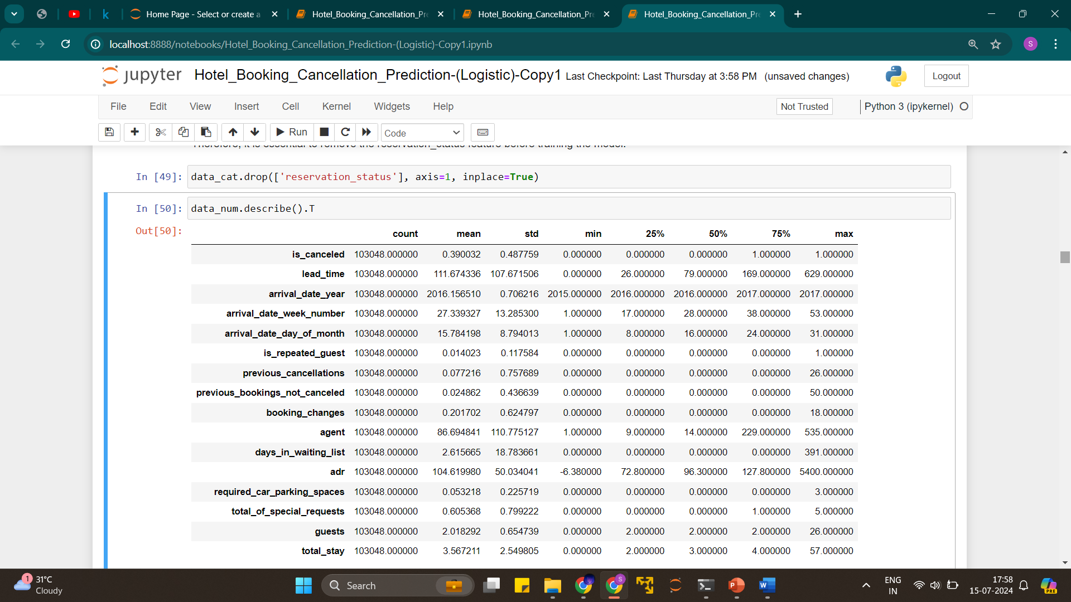
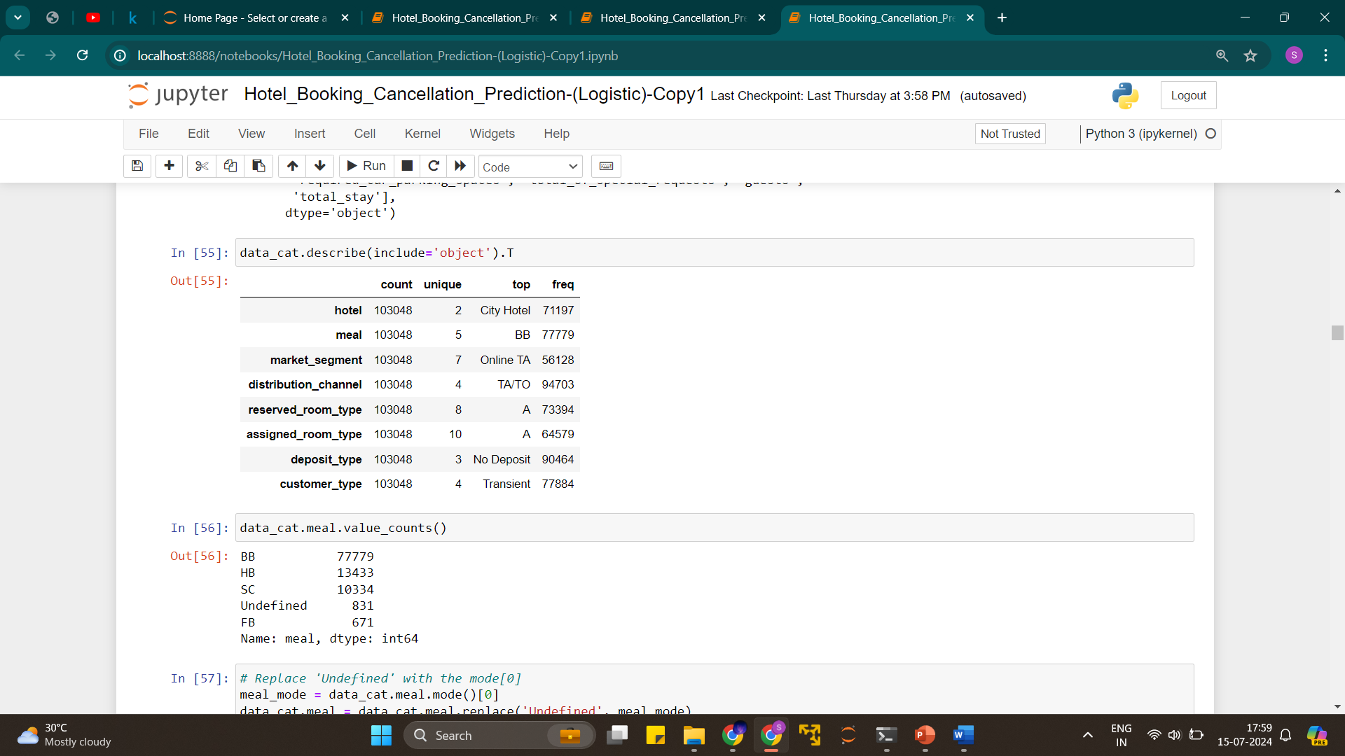

Slide 12
Exploratory Data Analysis

Slide 13
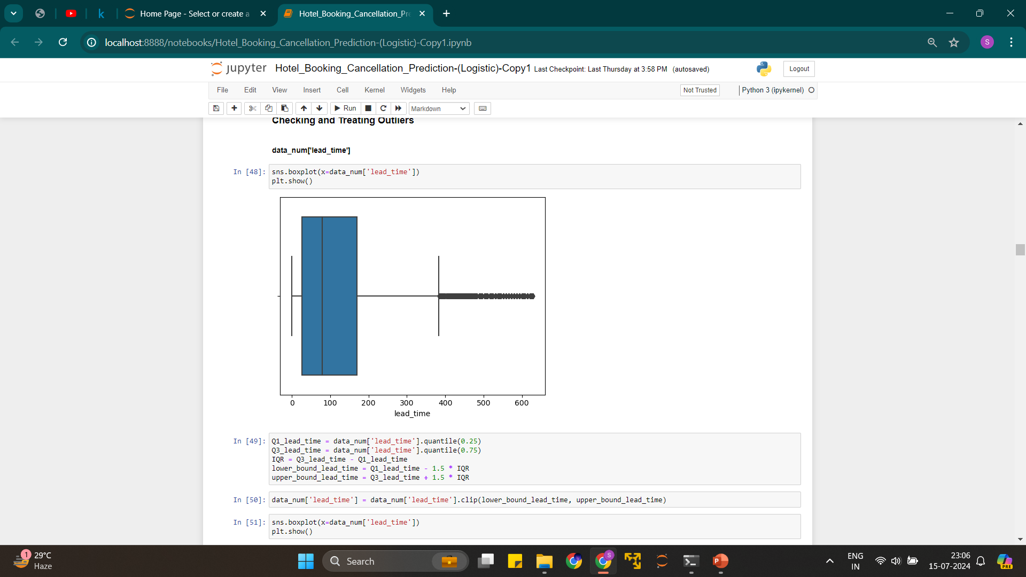
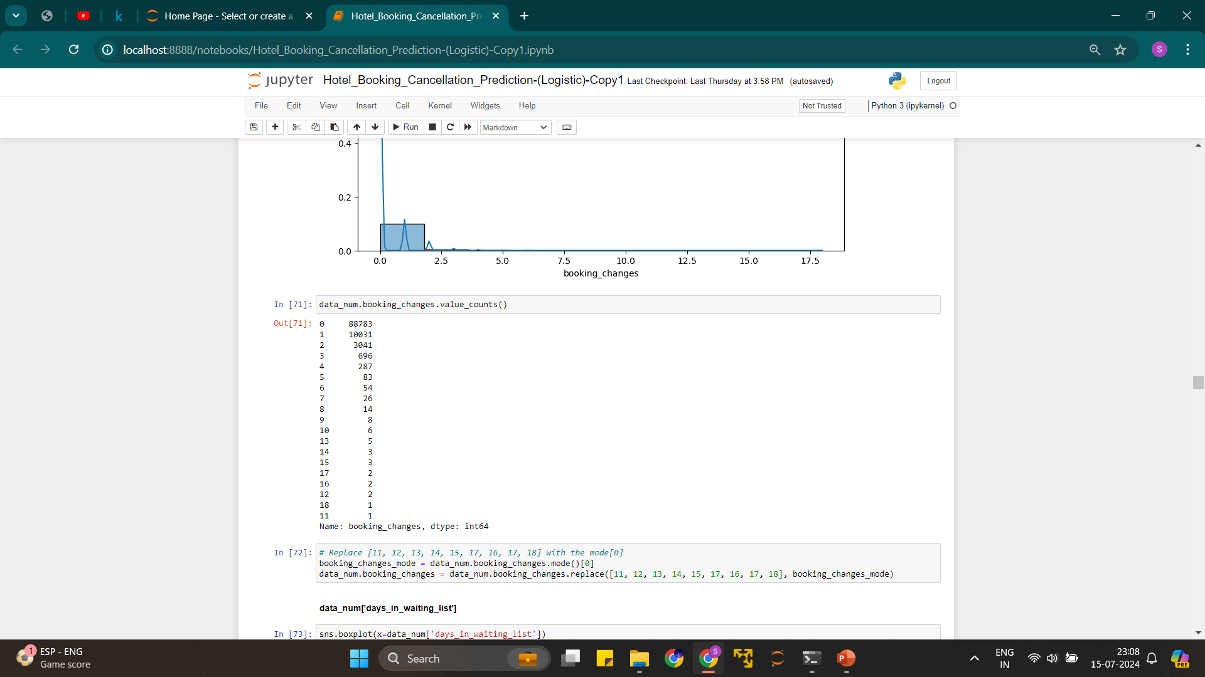
Handling outliers using the Winsorization or clipping method
Replacing unrealistic values with mode

Slide 14
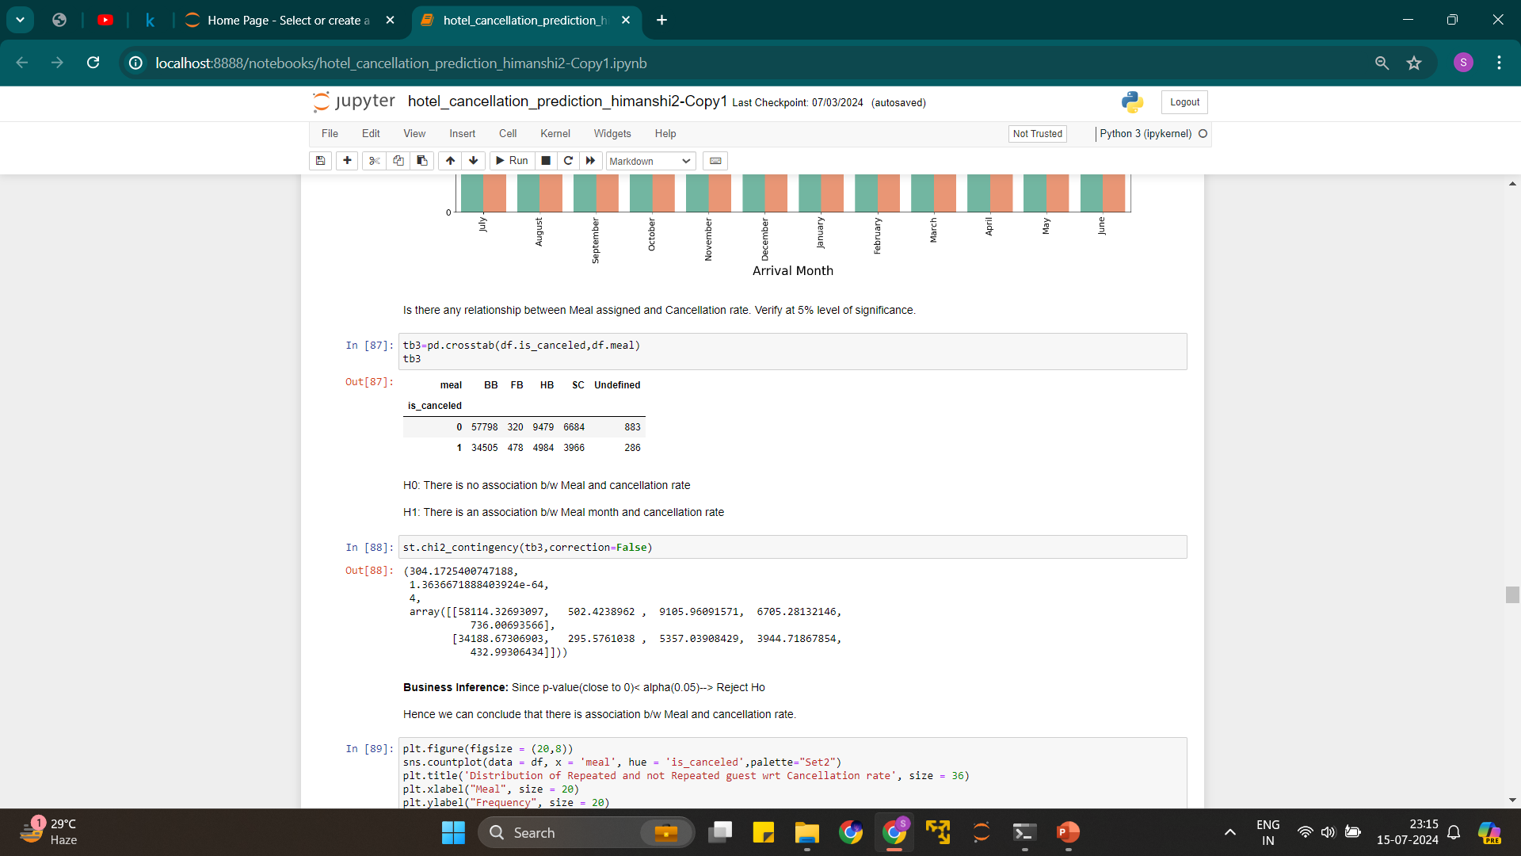
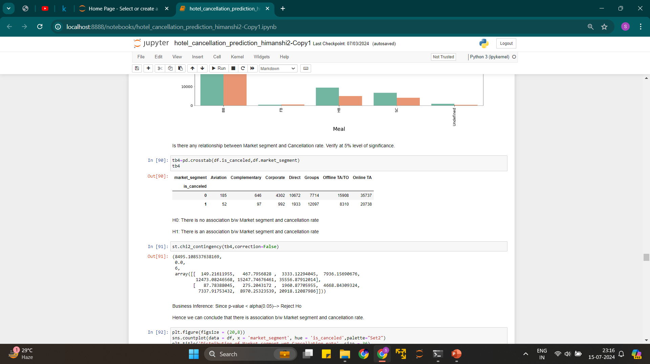

Slide 15
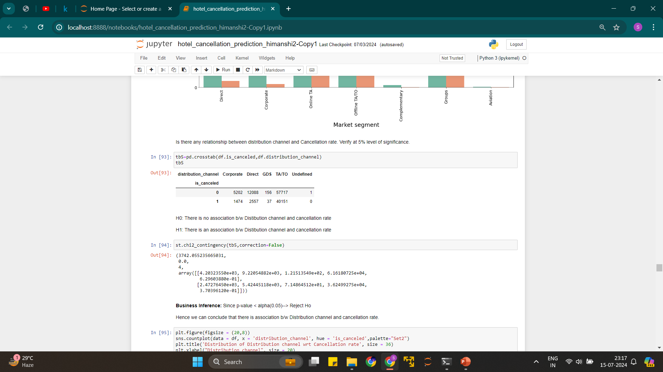
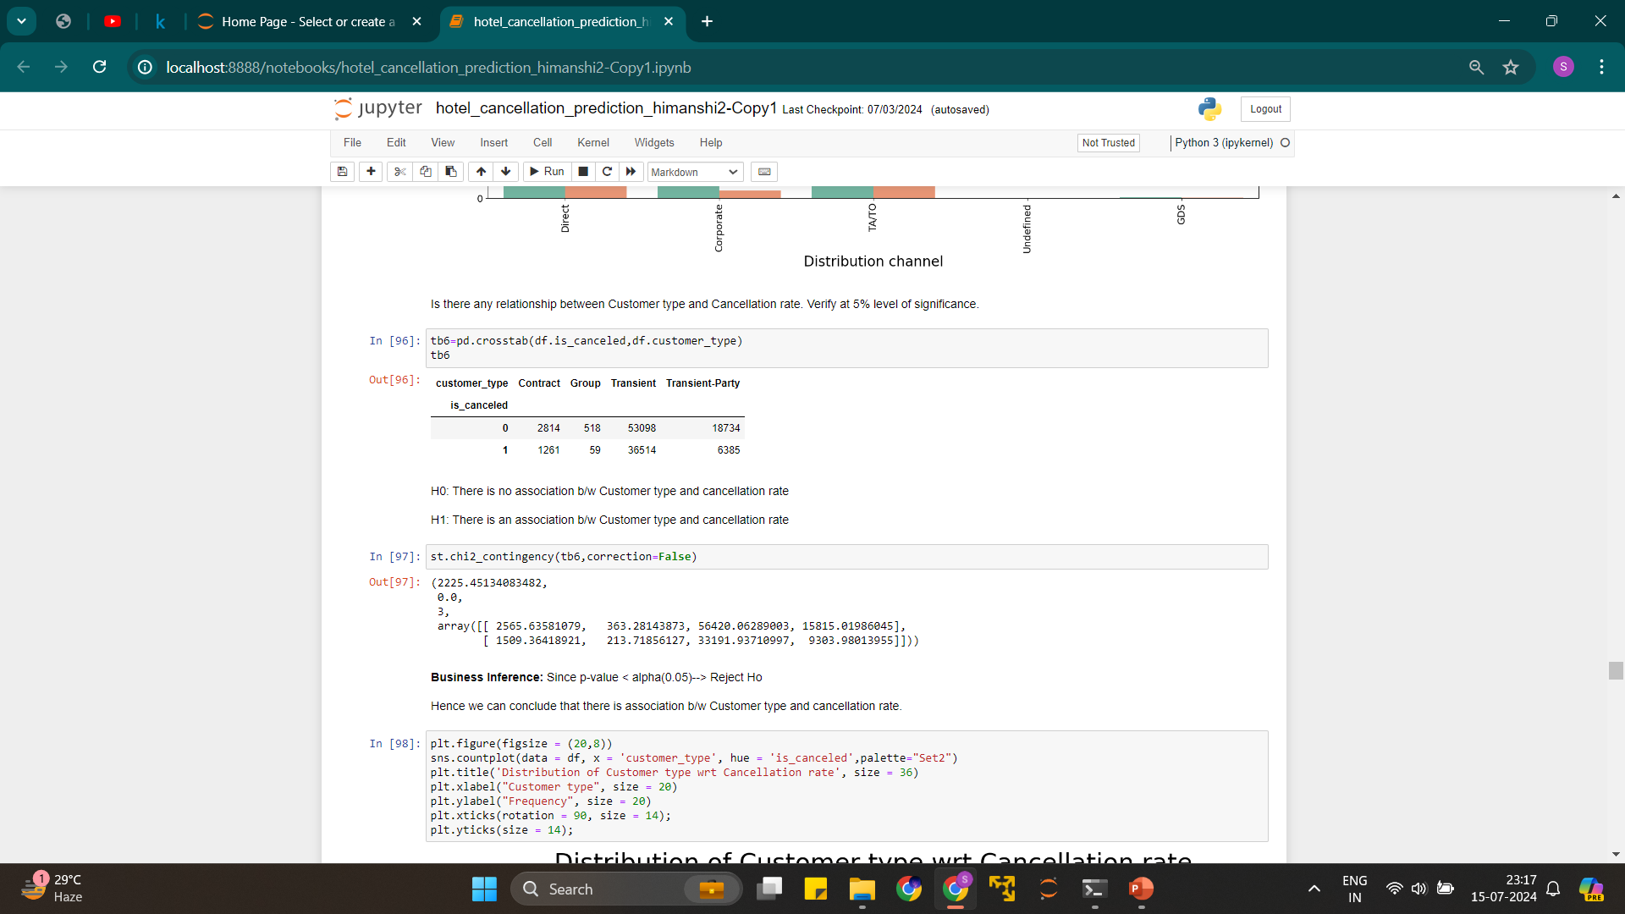

Slide 16
Data Visualisation

Slide 17
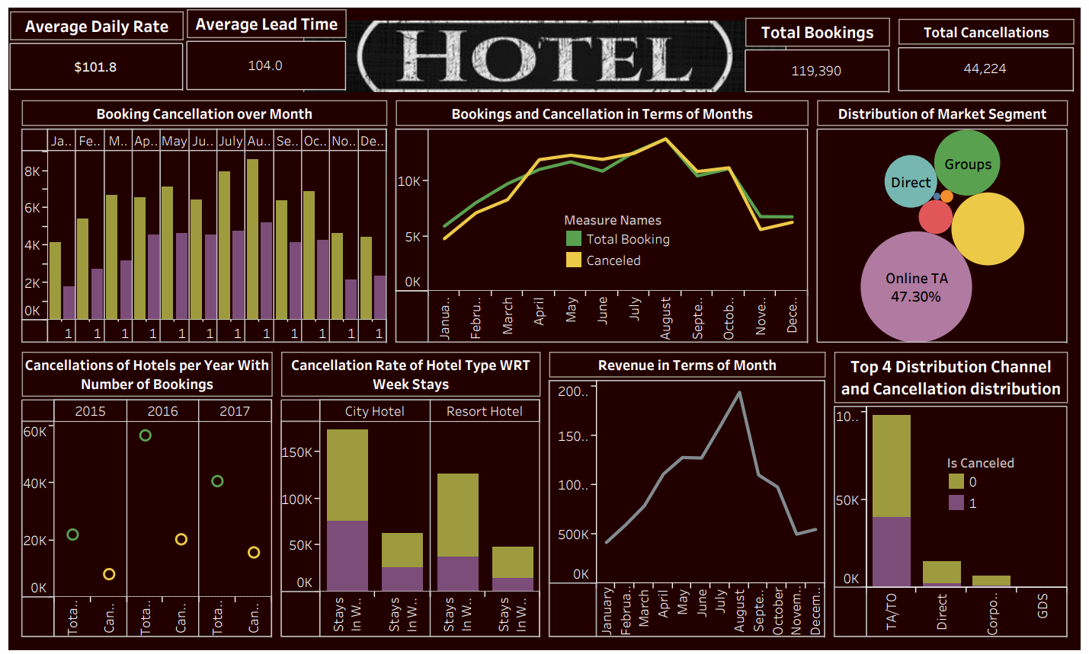
Tableau Dashboard

Slide 18
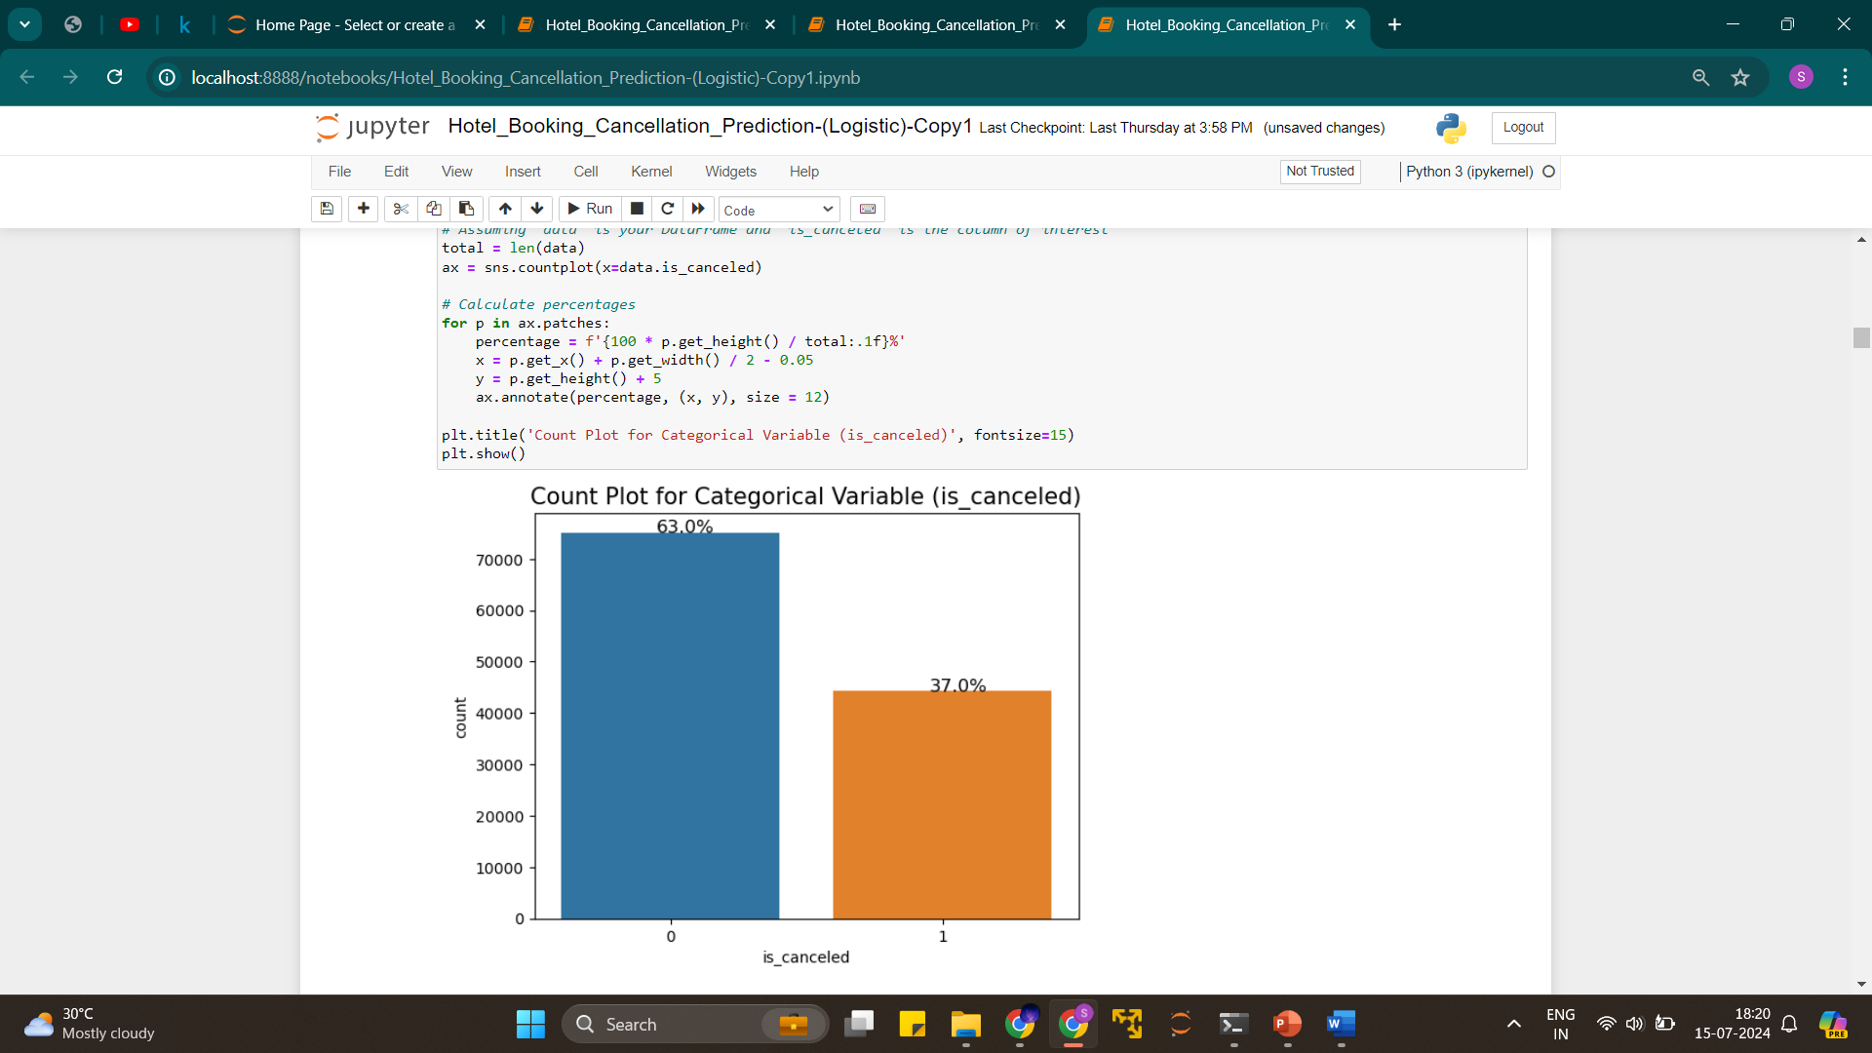
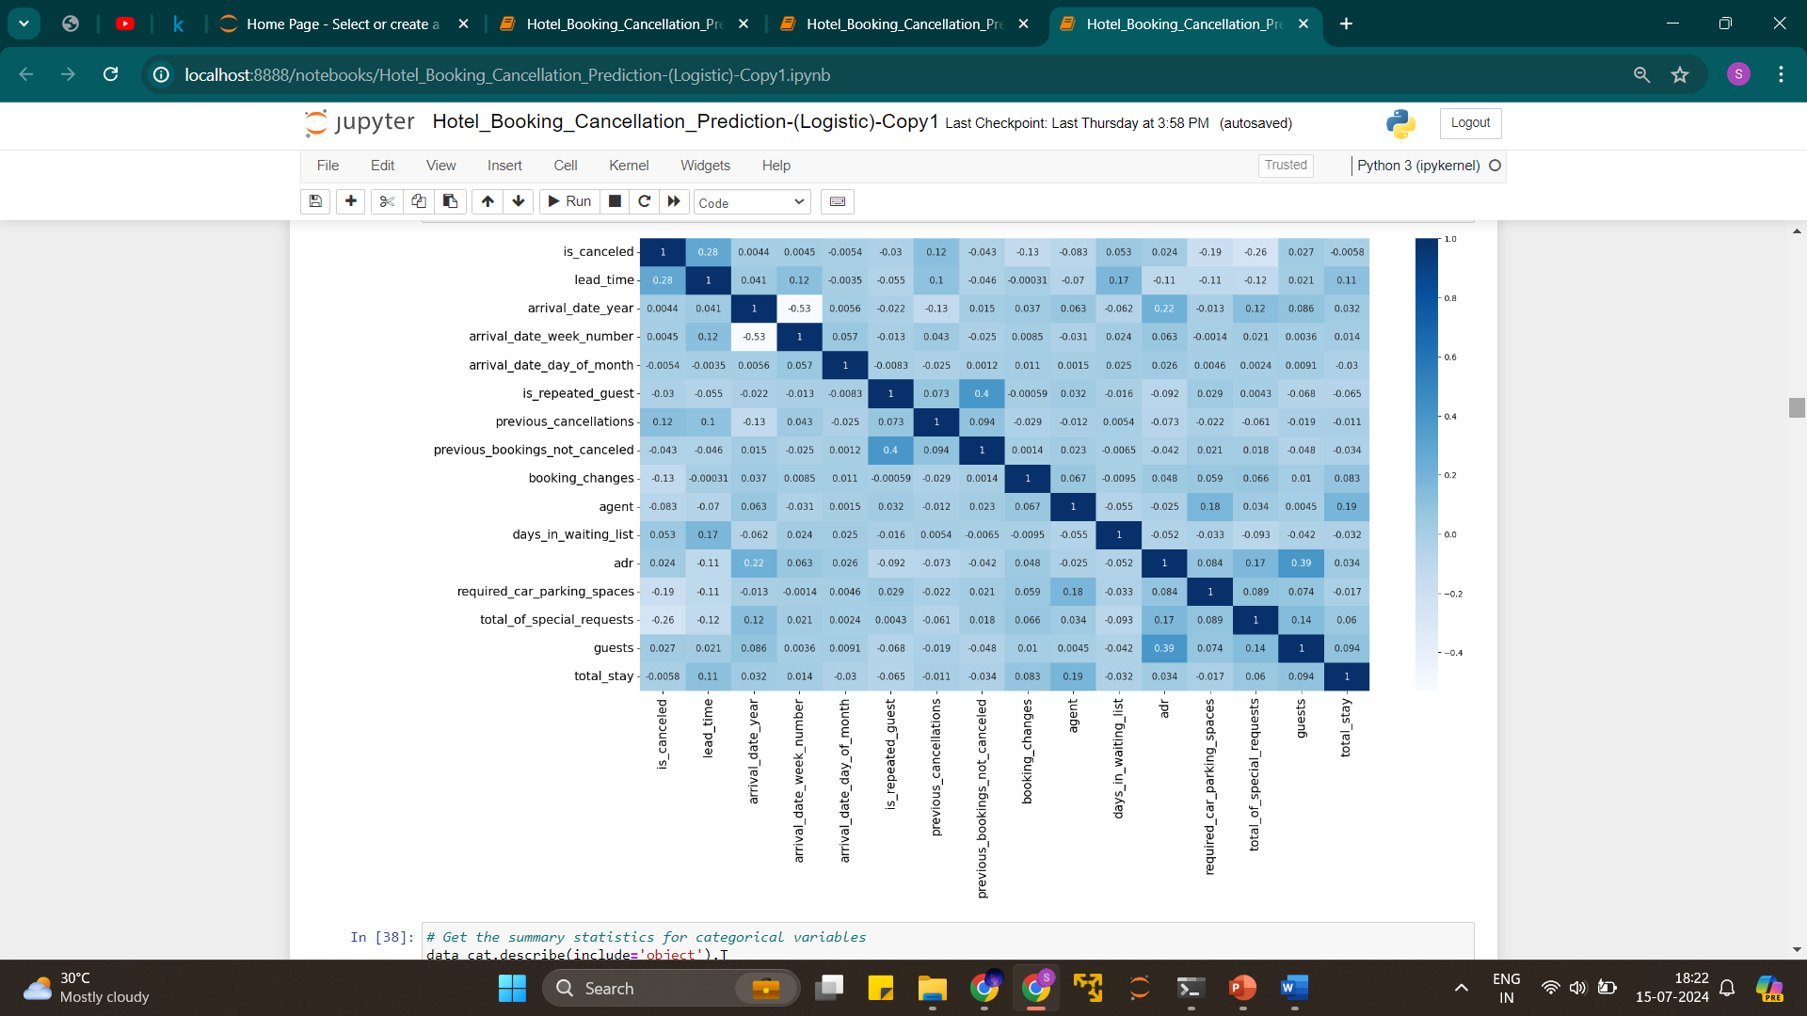
Correlation between Numerical Variables
Majority of Bookings are Not Canceled:
62.96% of the bookings are not canceled (labeled as "0"). This indicates that most customers follow through with their hotel bookings.
Significant Cancellation Rate:
37.04% of the bookings are canceled (labeled as "1"). While less than the non-canceled rate, this still represents a substantial portion of the total bookings,
suggesting that over a third of the bookings do not proceed as planned.

Slide 19
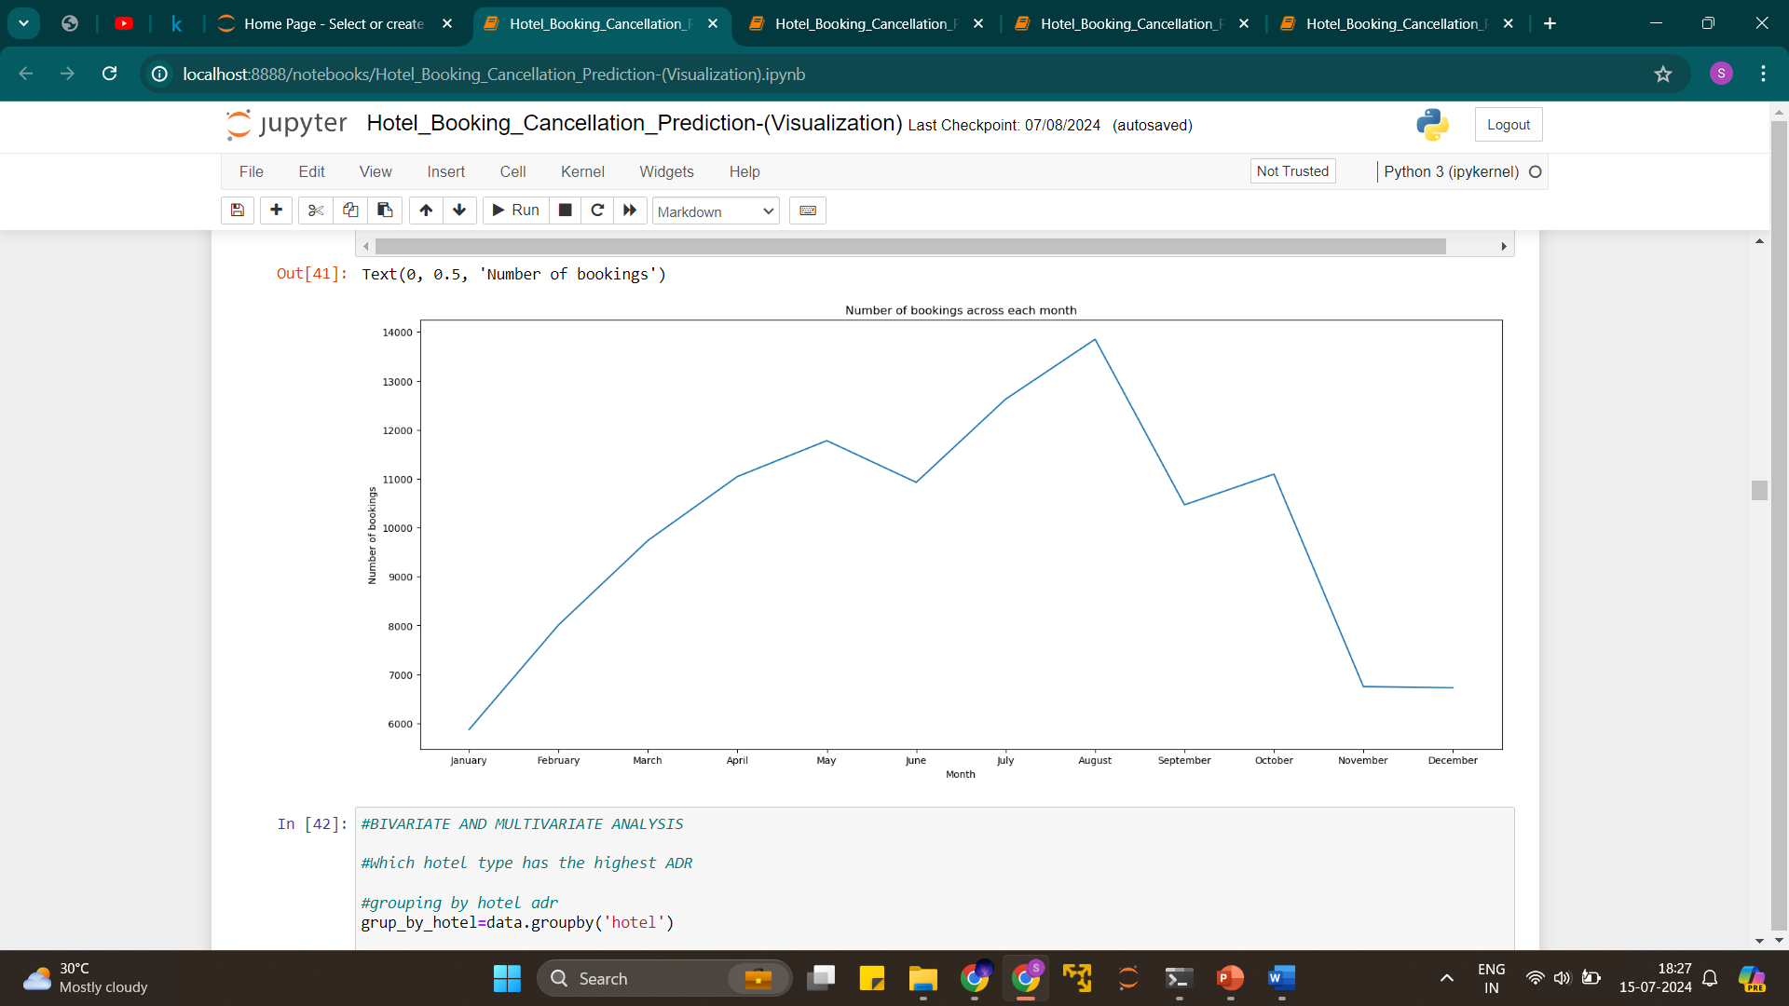
August has maximum no. of bookings and January, December has least bookings,
Therefore we can give discounts at the end of the year and starting of the year to grab more customers.

Slide 20
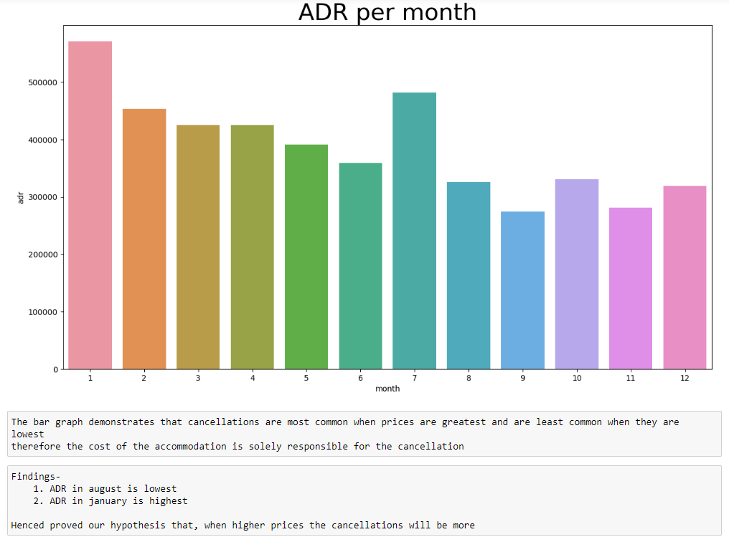

Slide 21
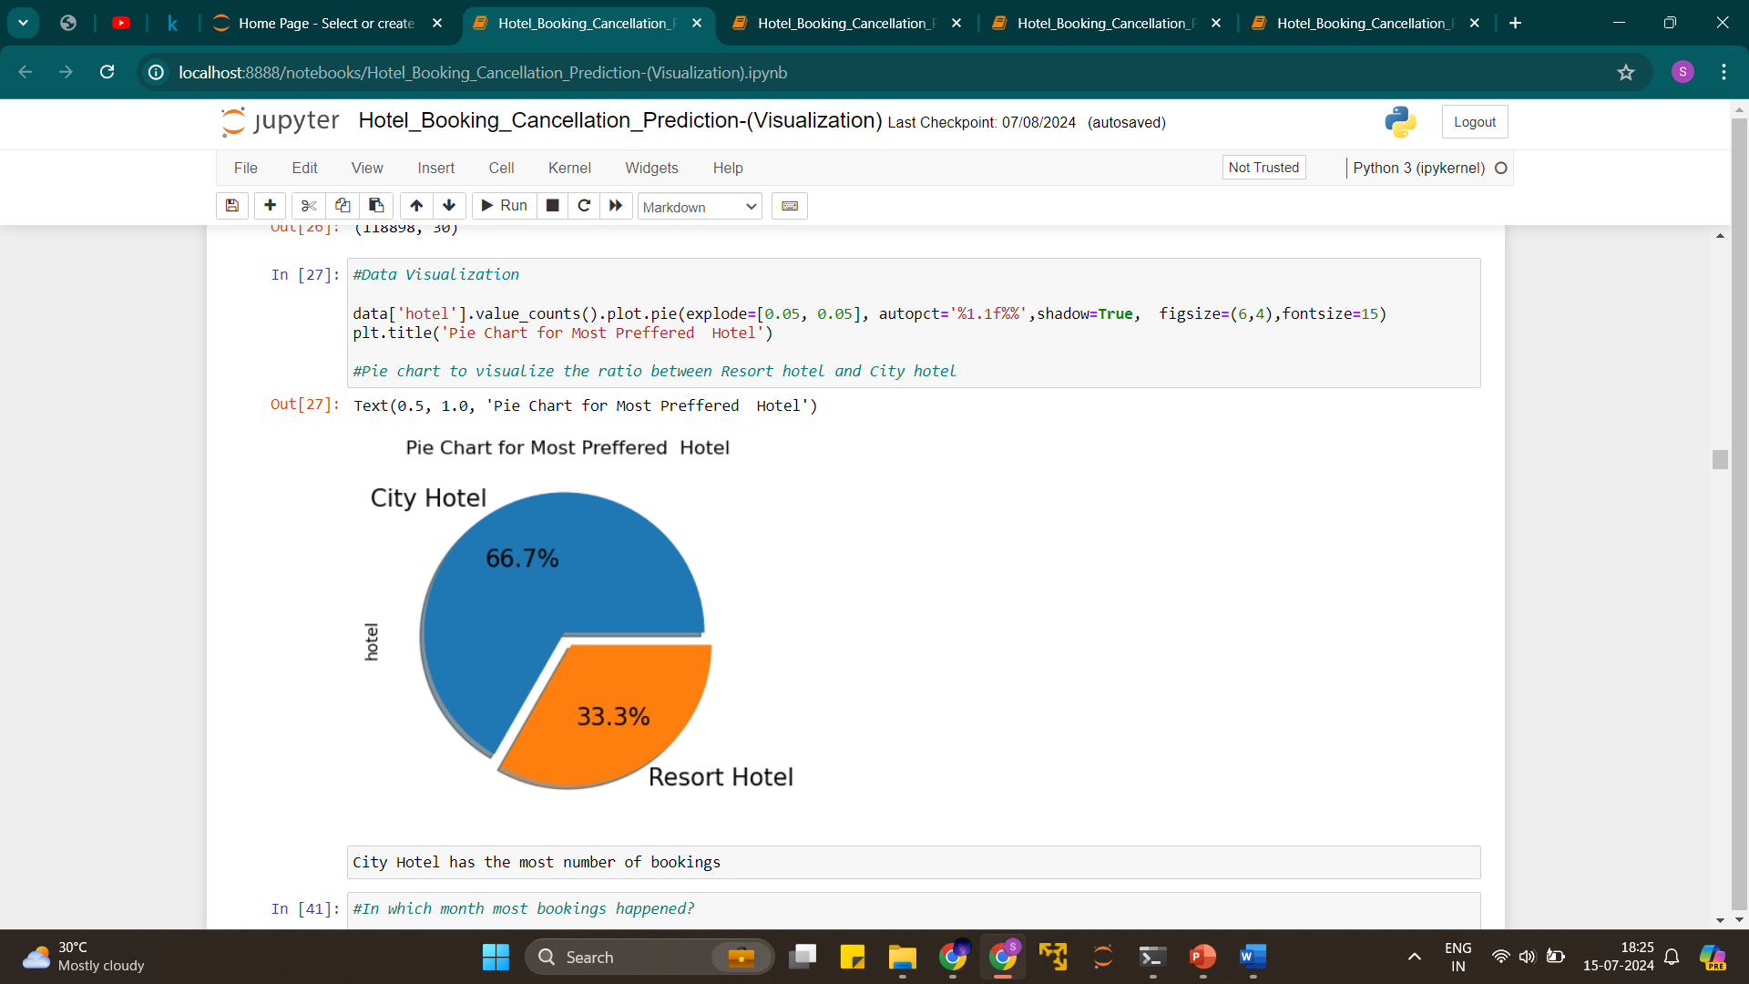
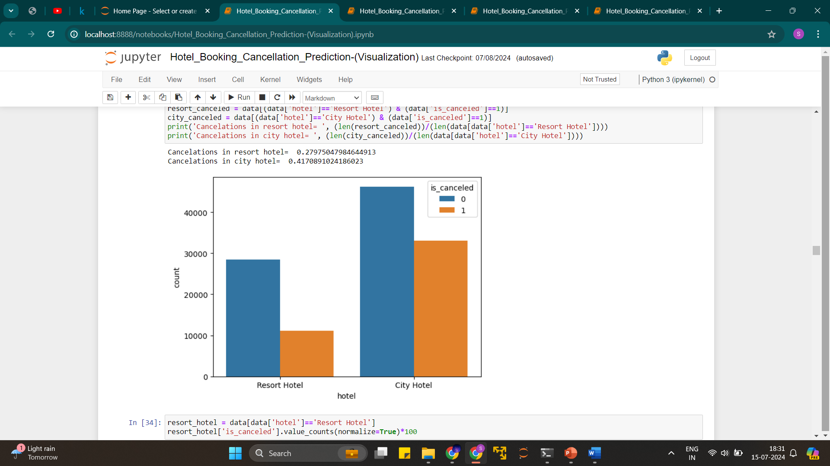
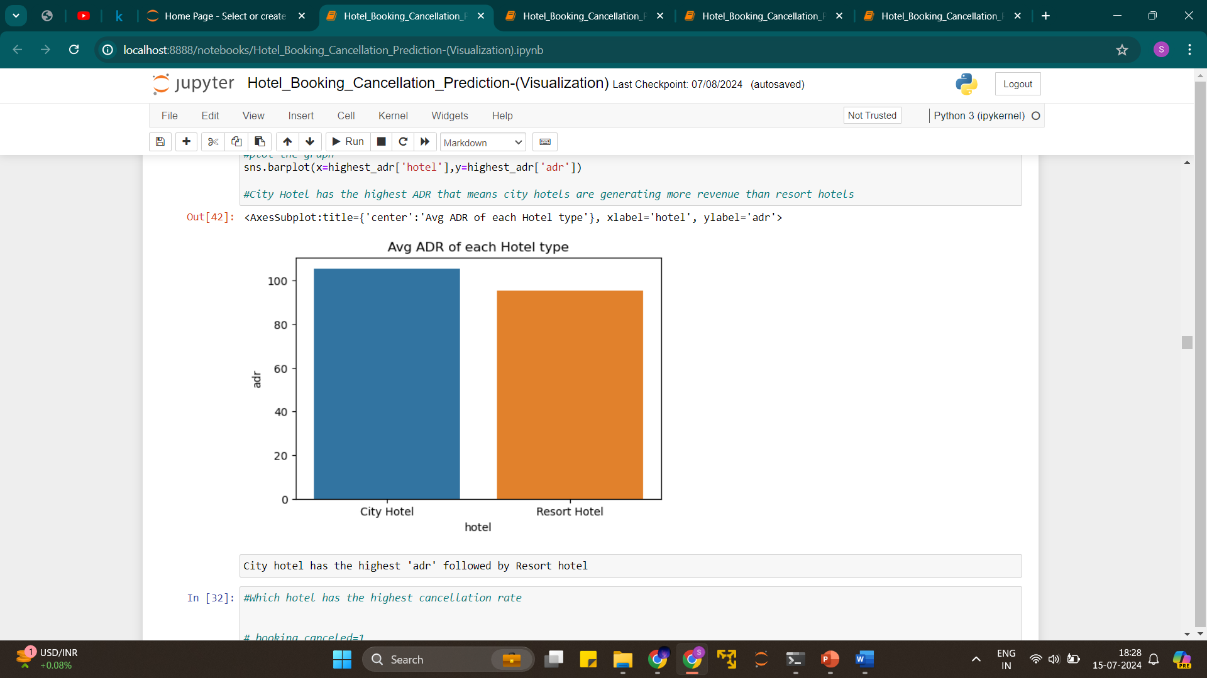

Slide 22
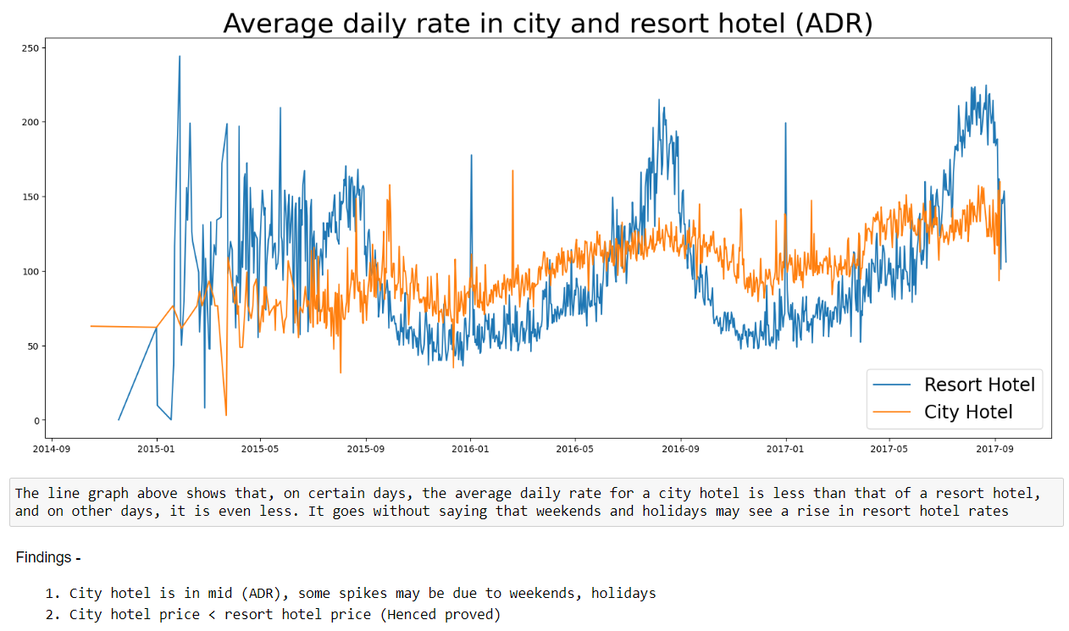

Slide 23
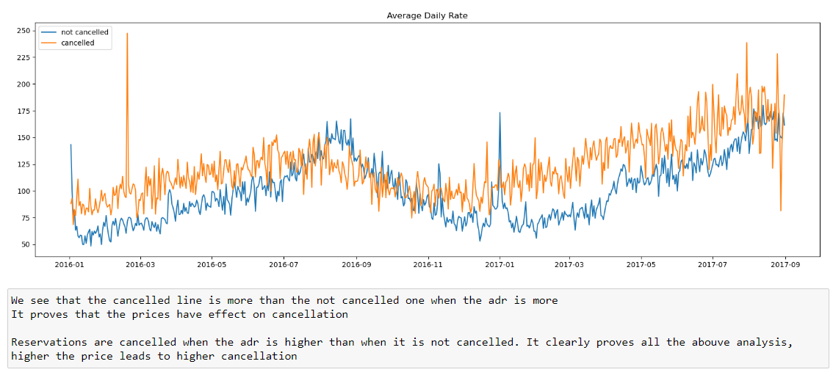

Slide 24
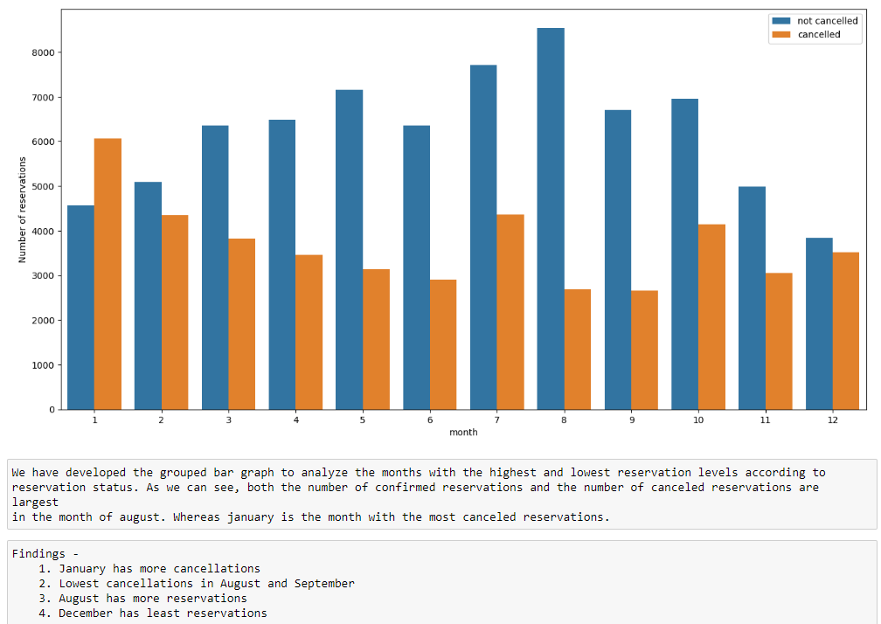

Slide 25
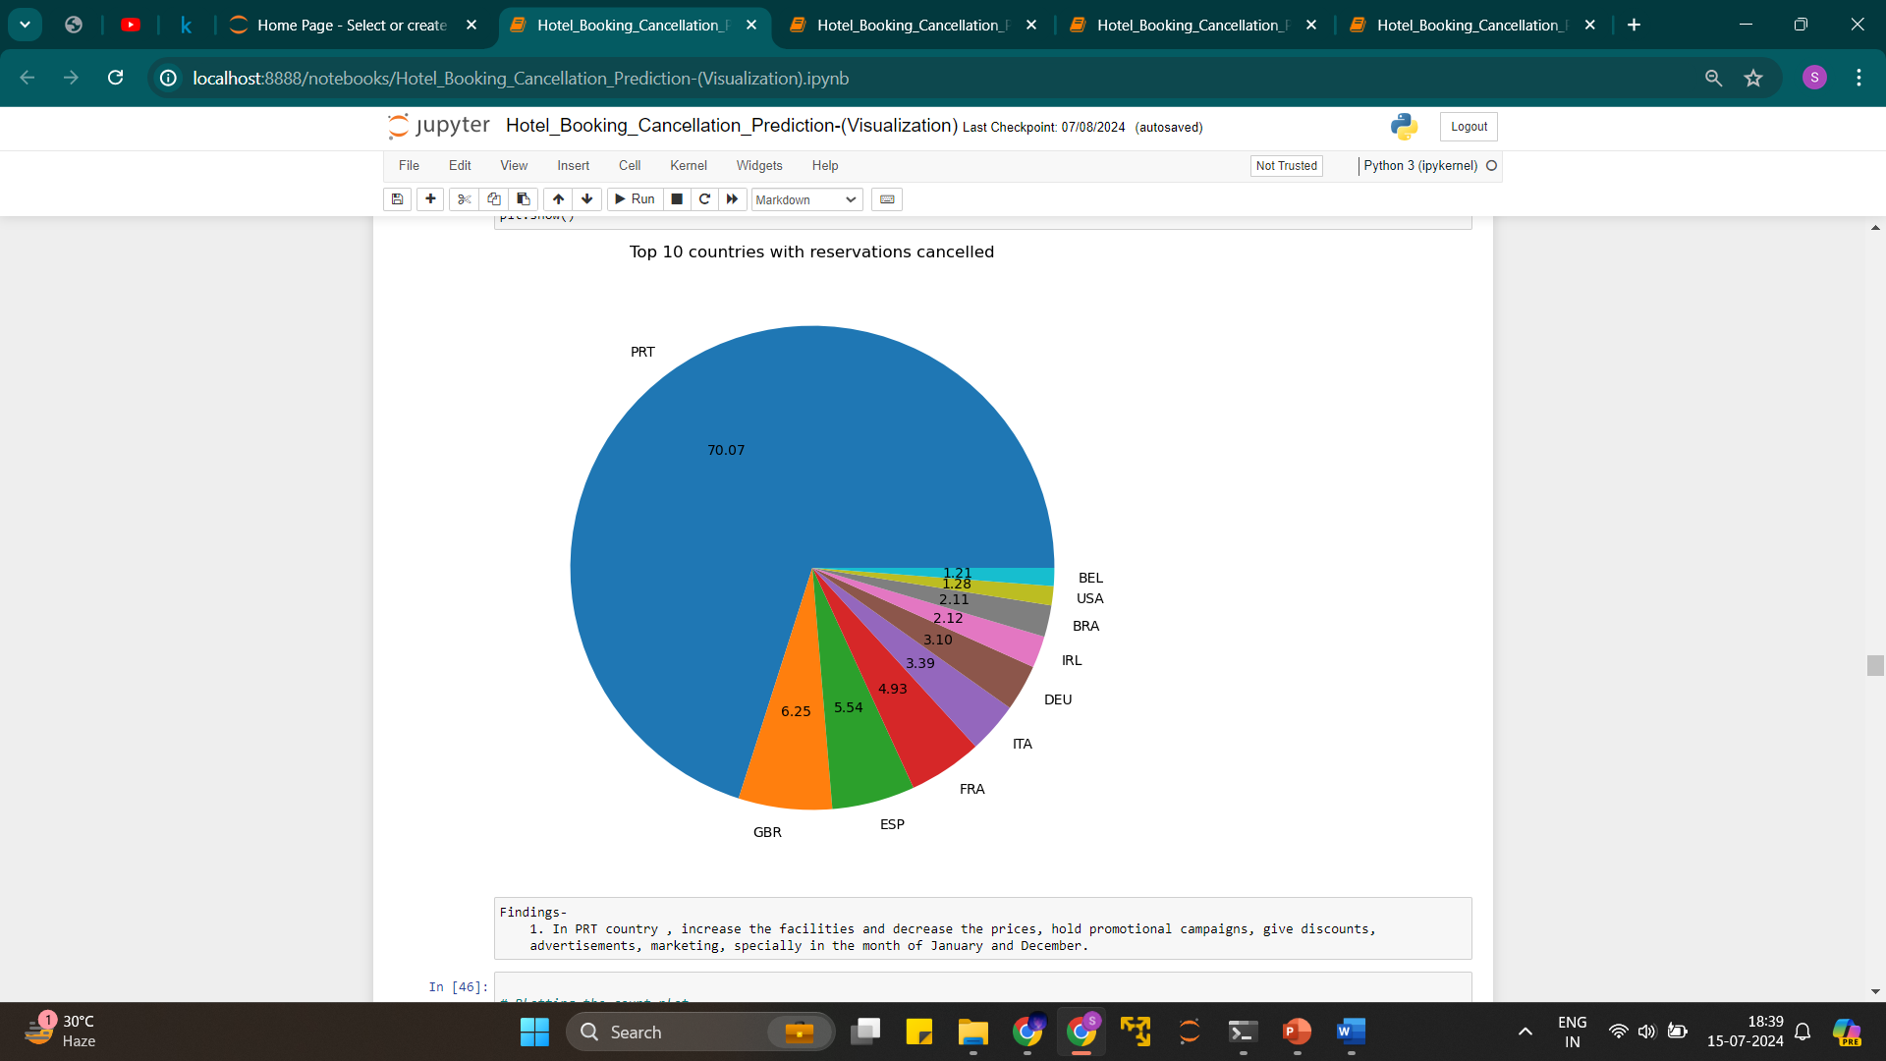
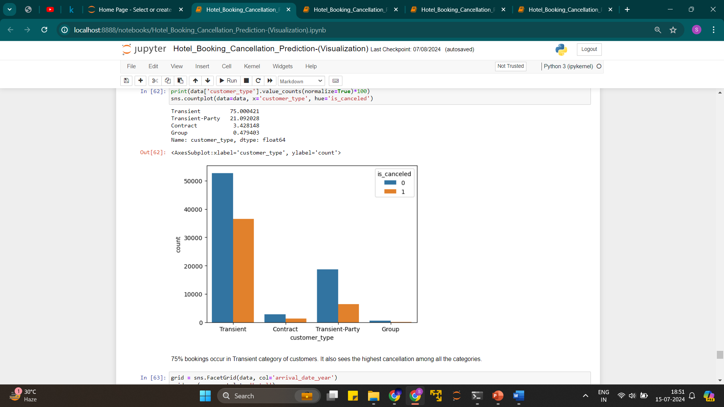

Slide 26
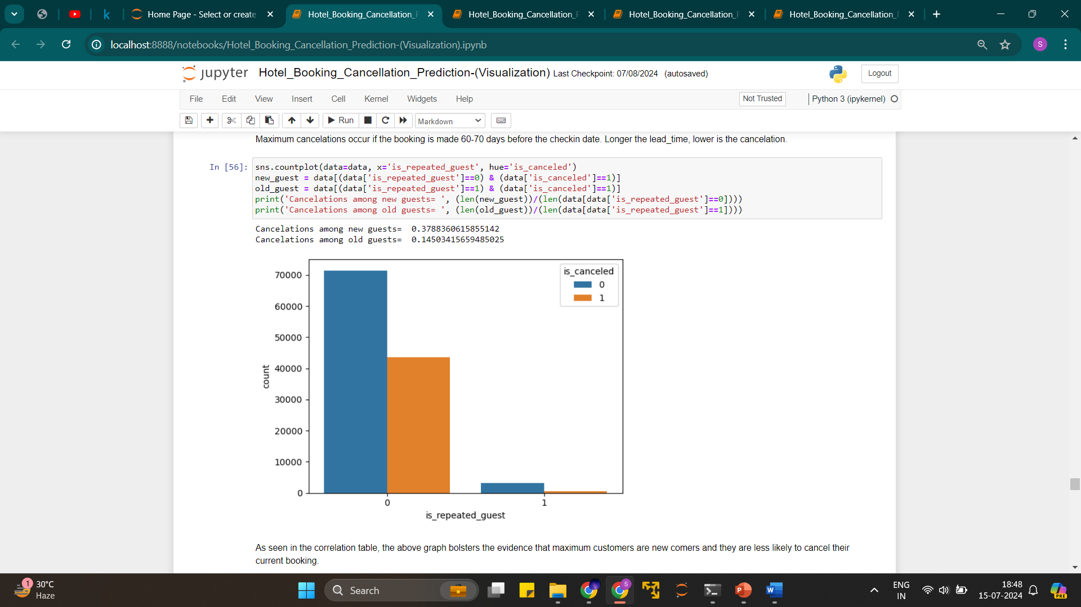
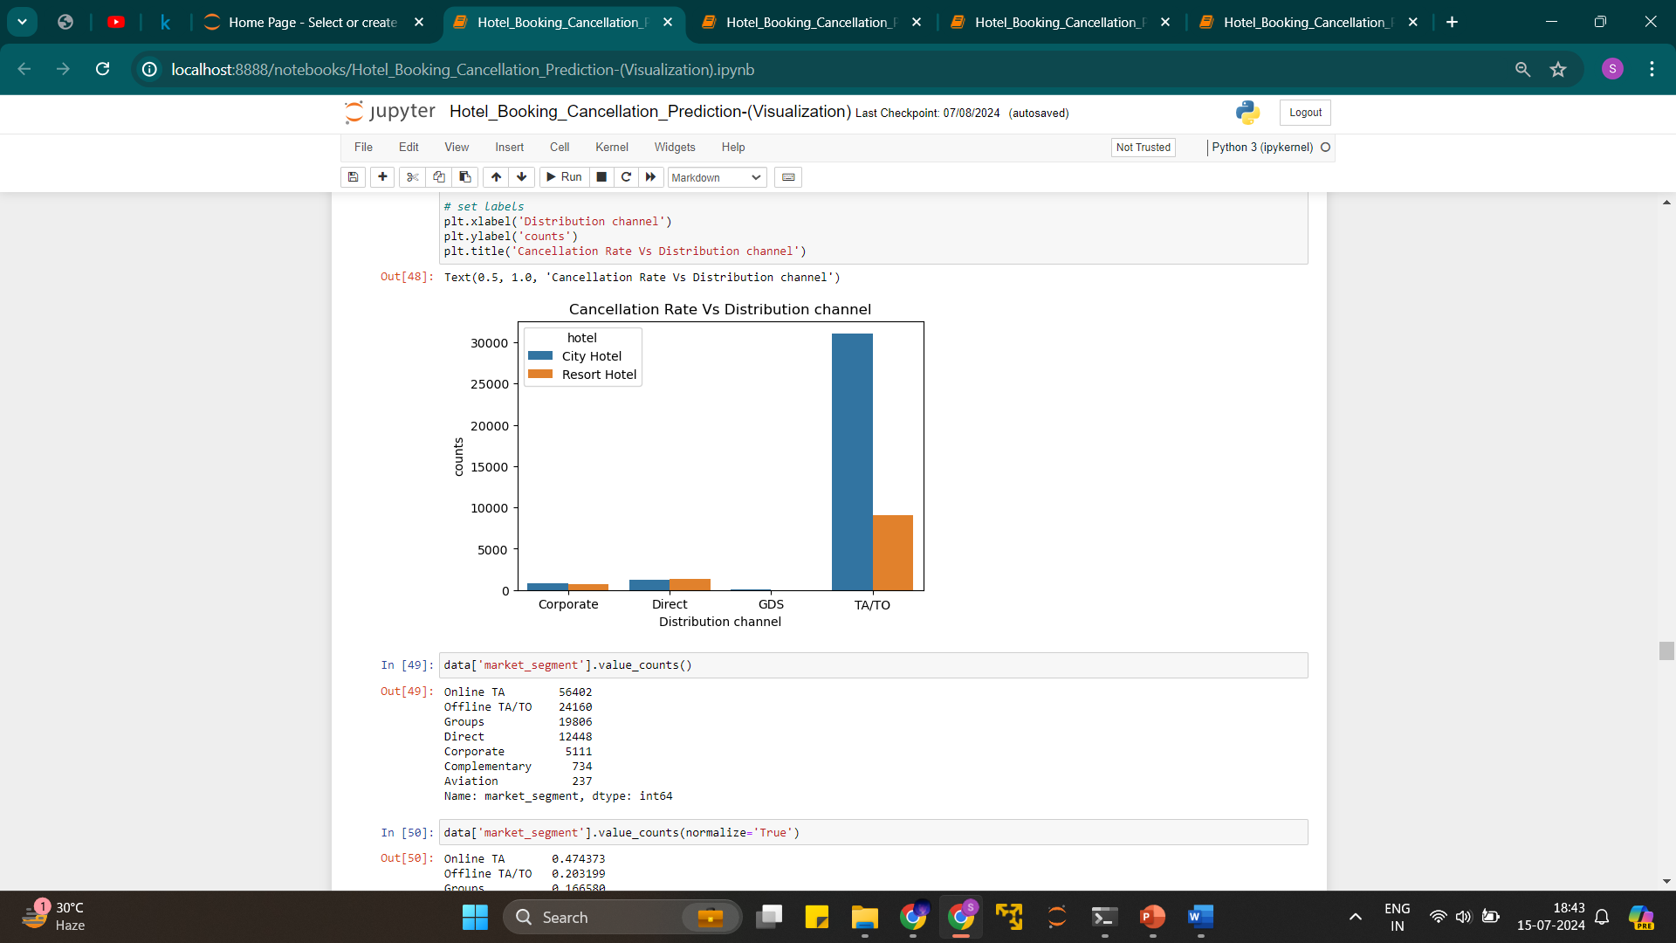
Distribution channel TA/TO has most number of cancellation

Slide 27
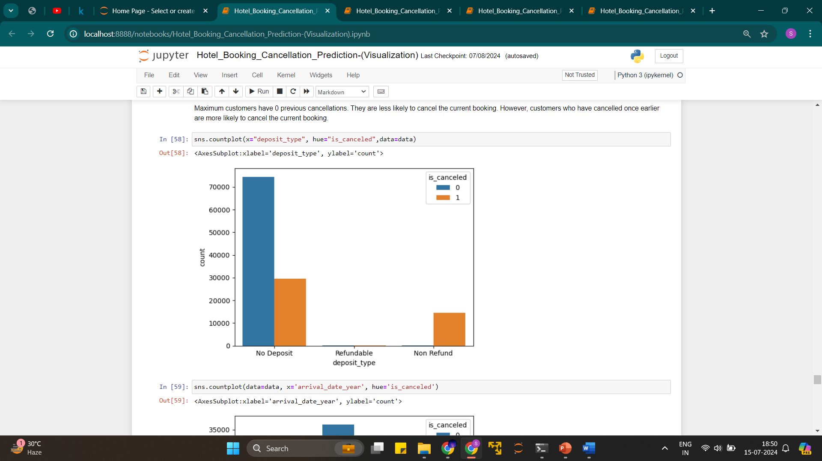
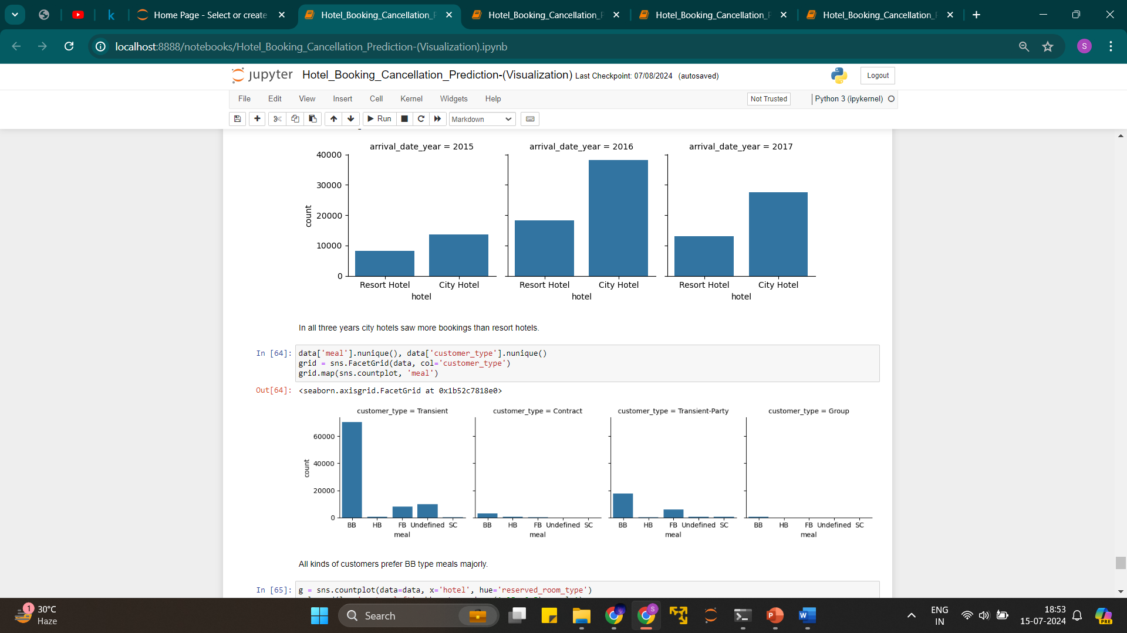
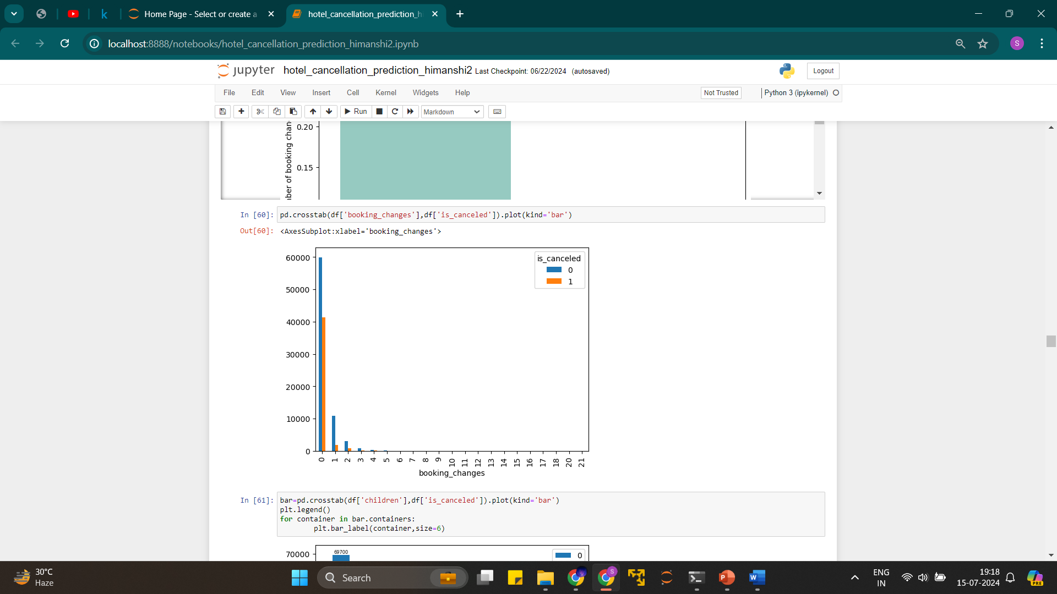

Slide 28
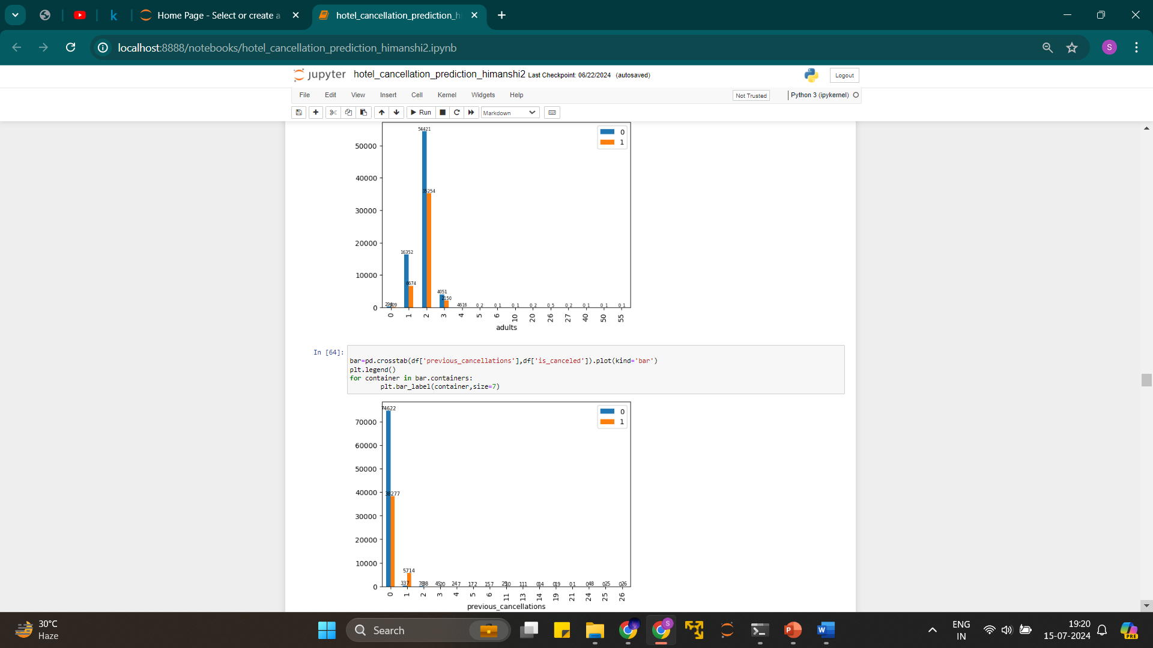

Slide 29
Data Preparation

Slide 30
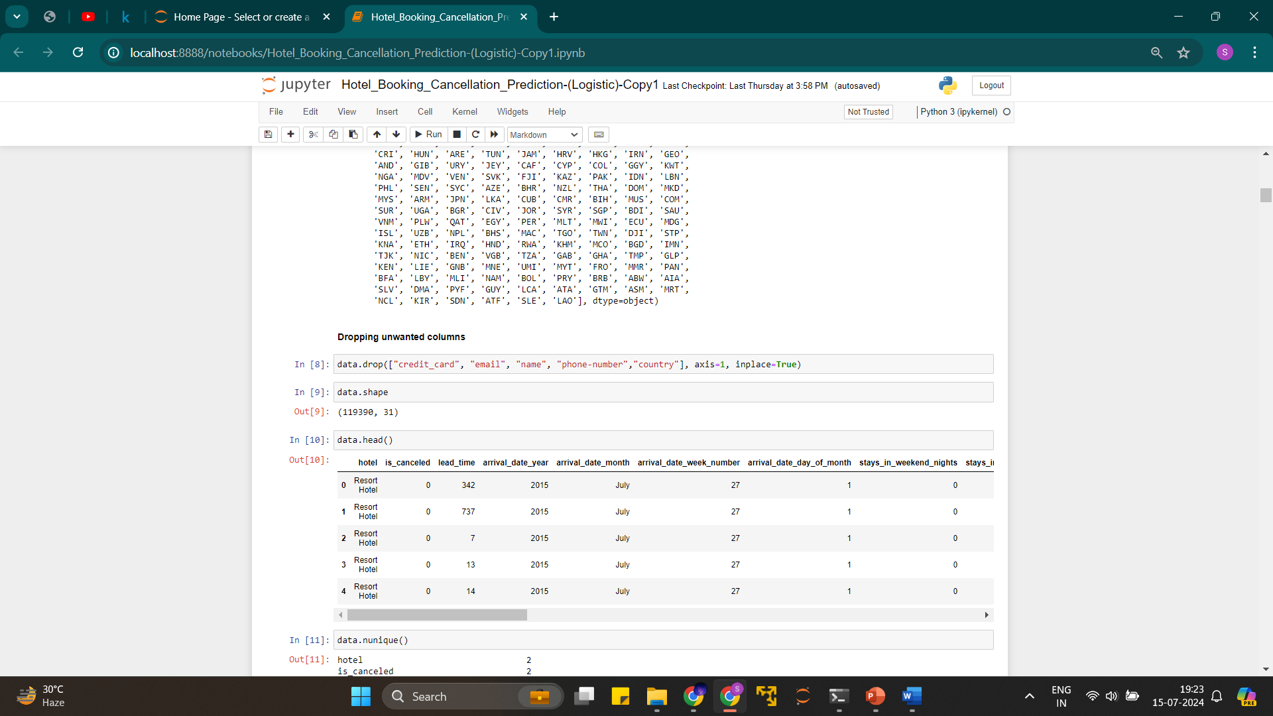
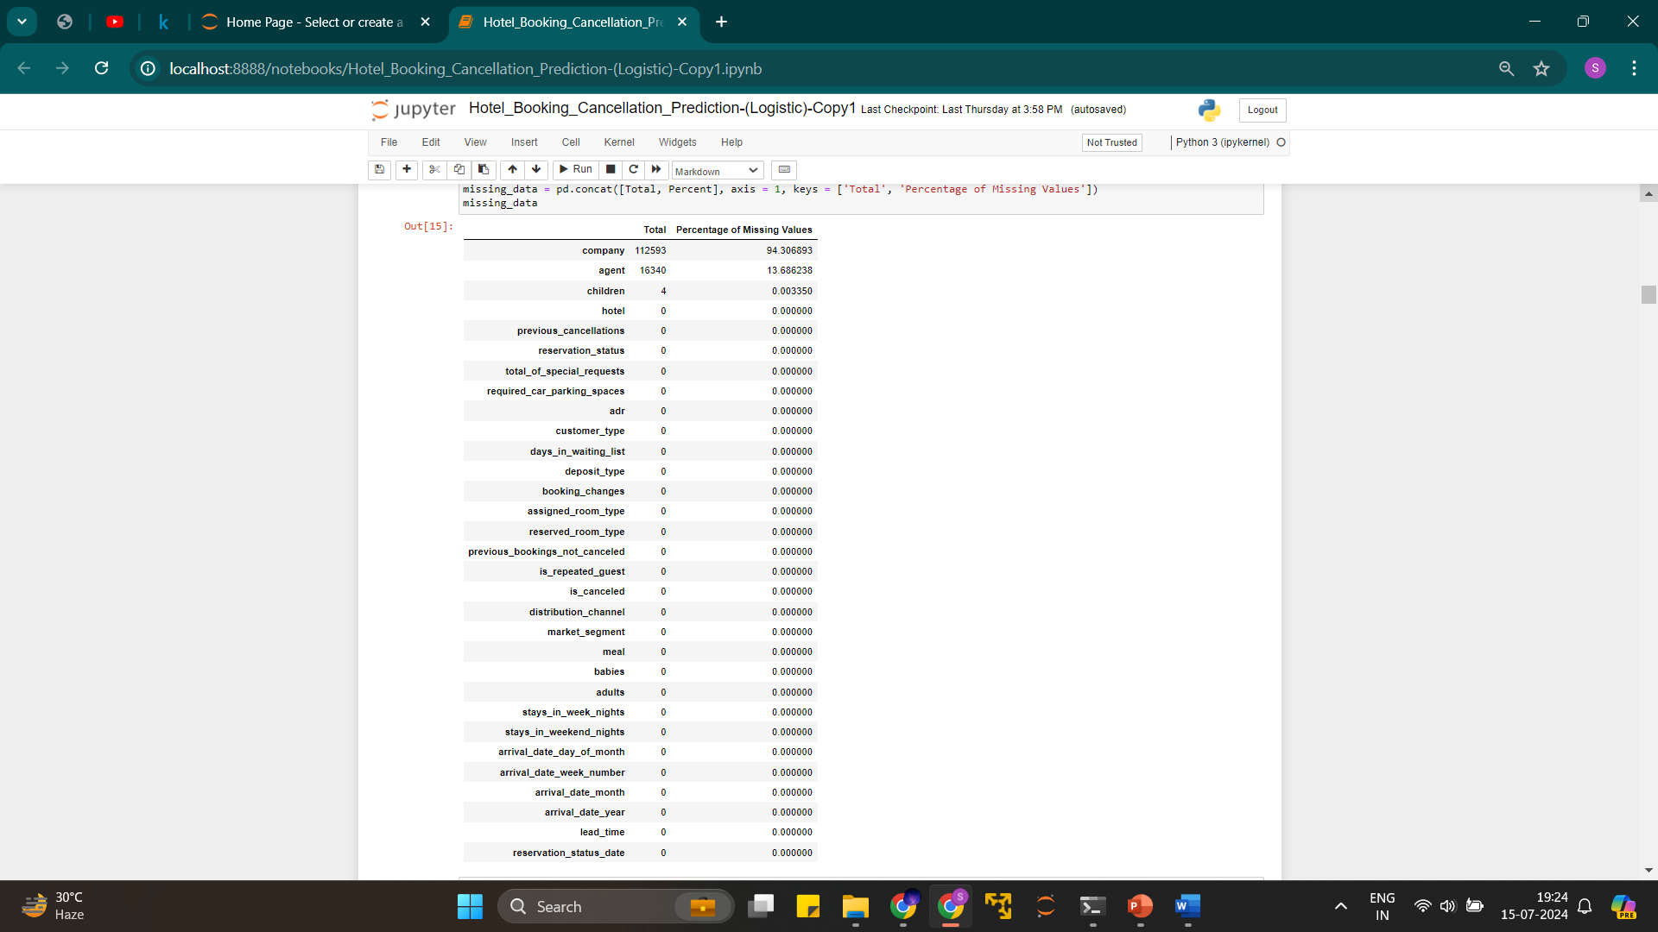
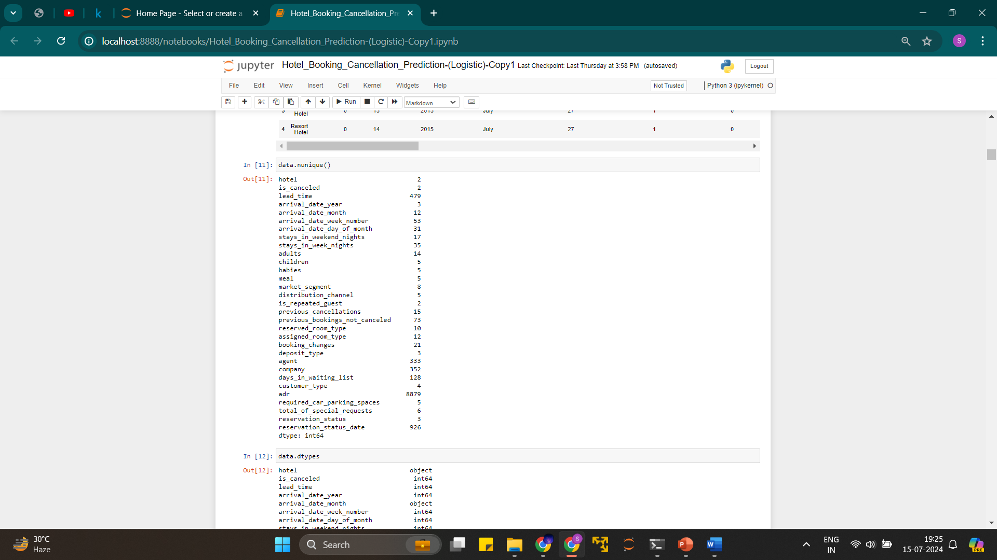

Slide 31
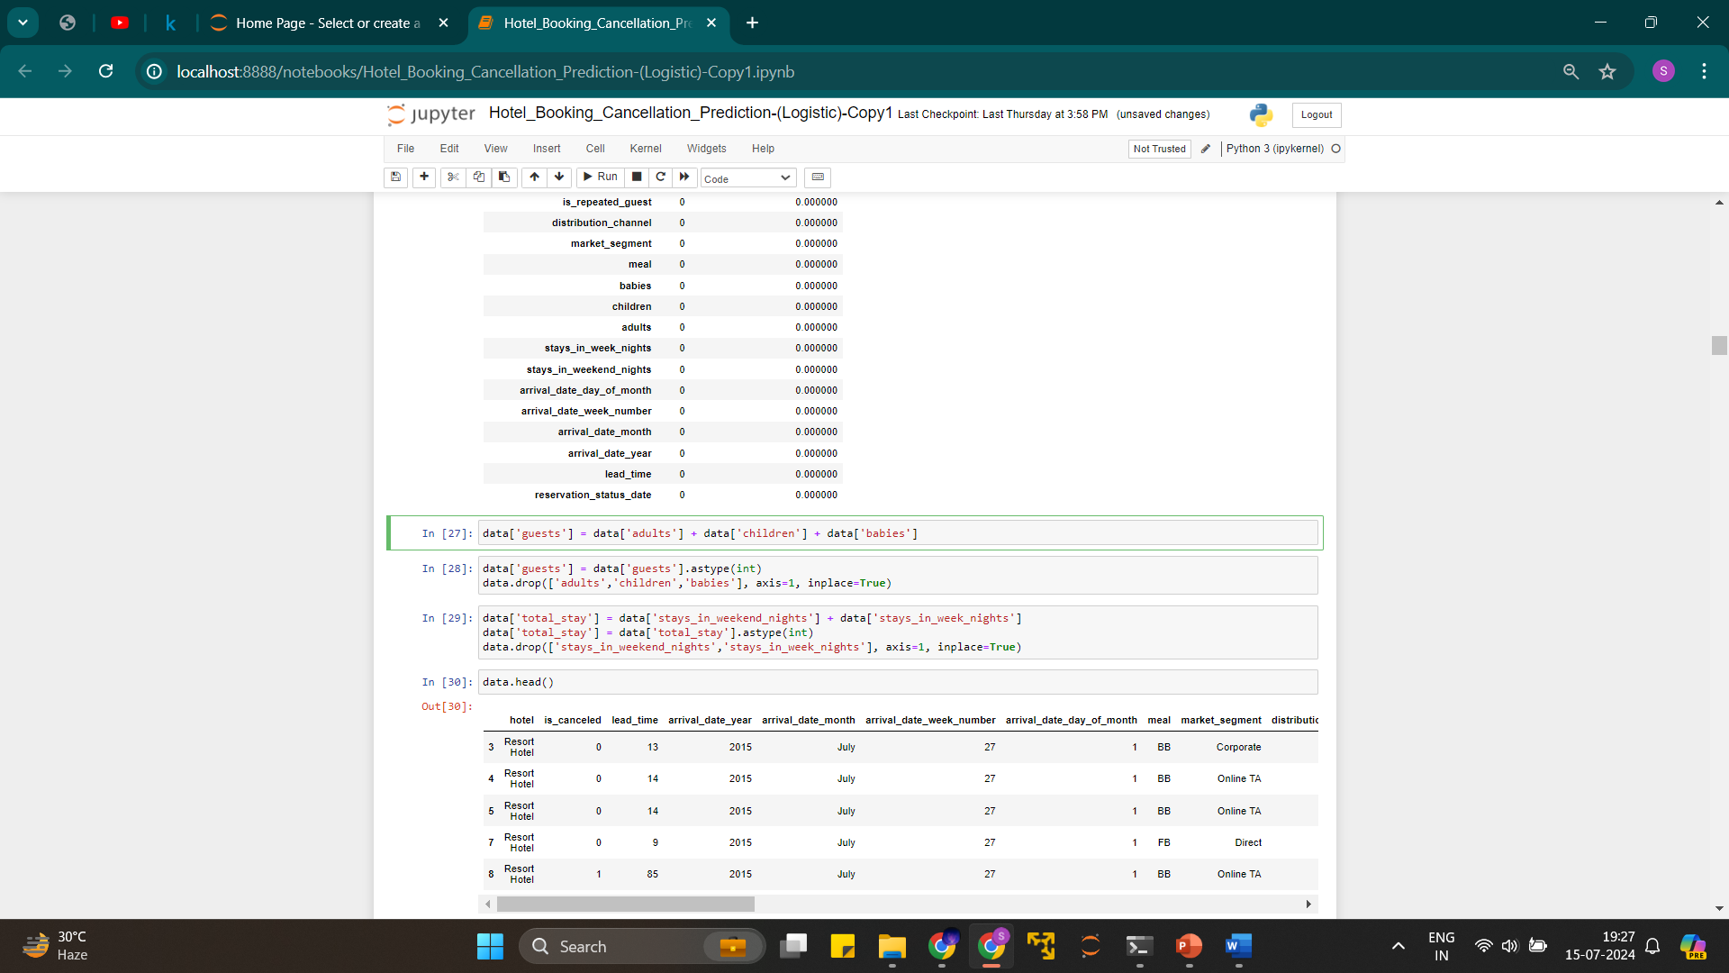
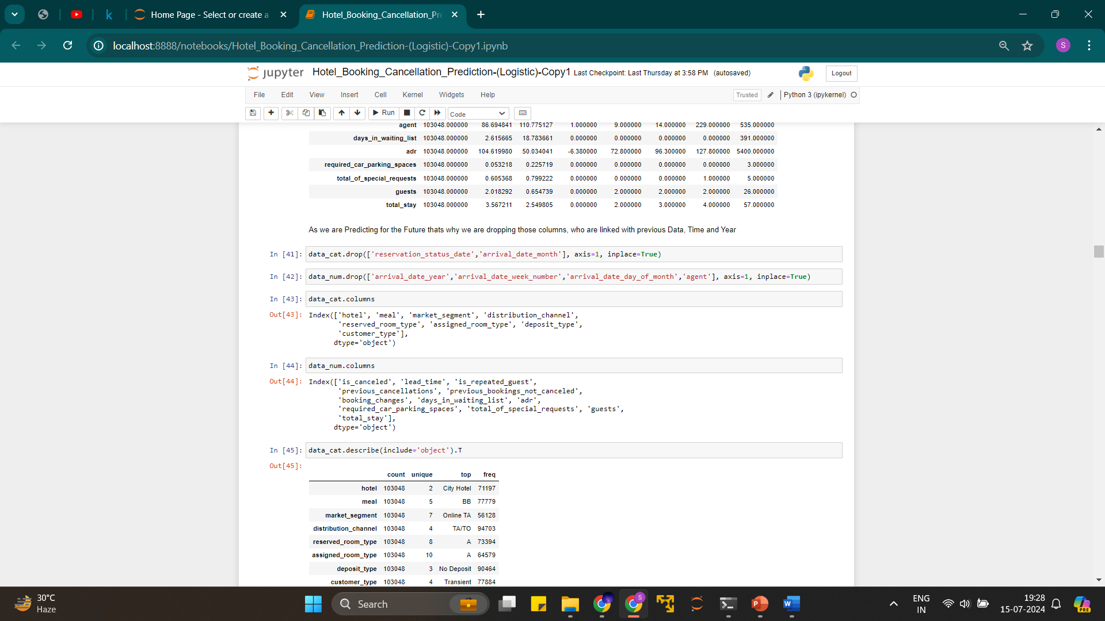
Feature Engineering

Slide 32
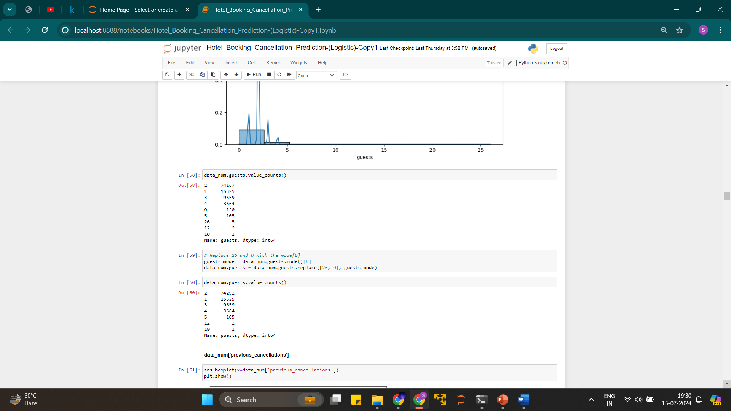
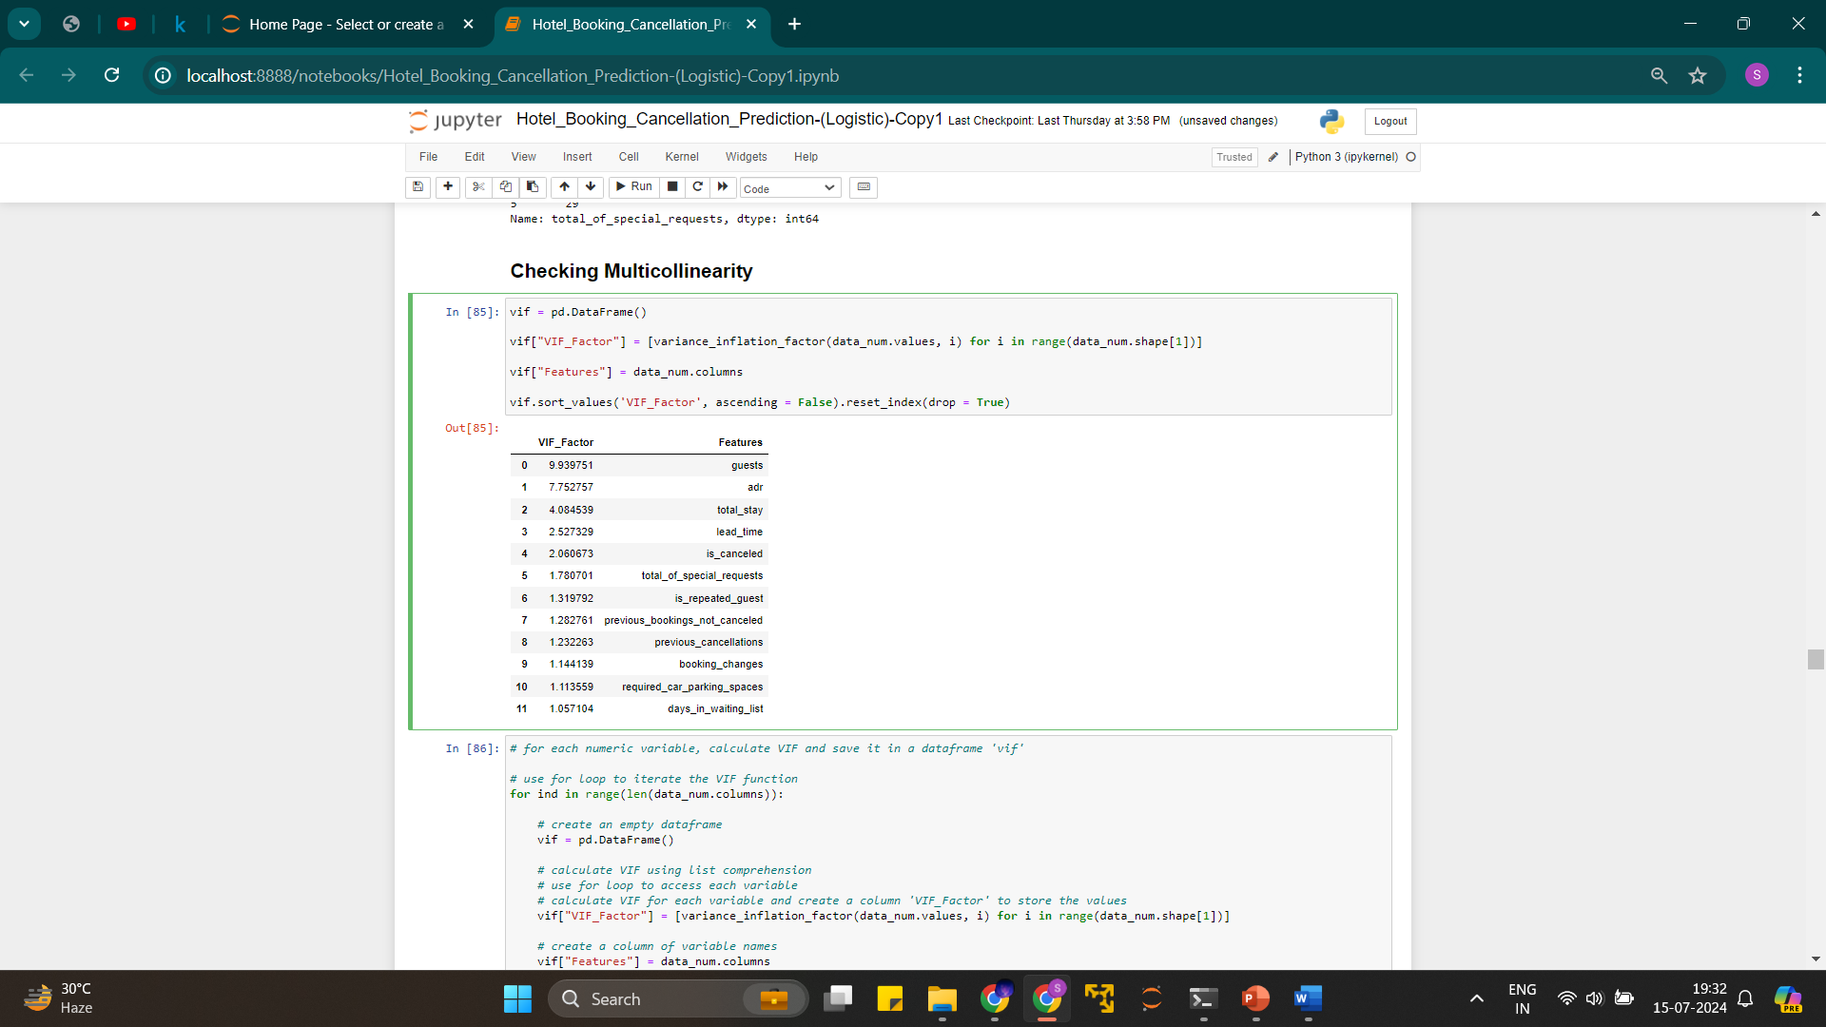

Slide 33
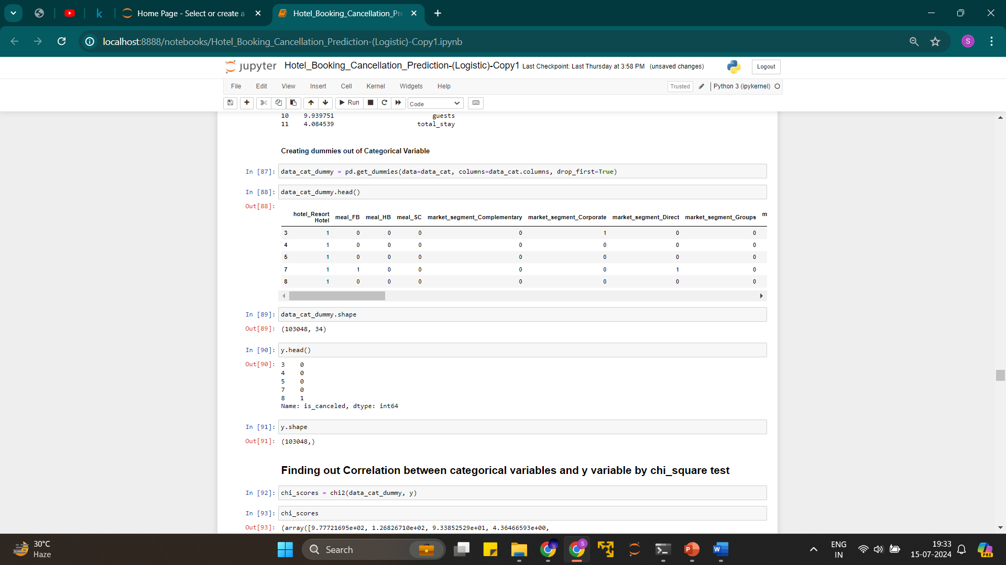
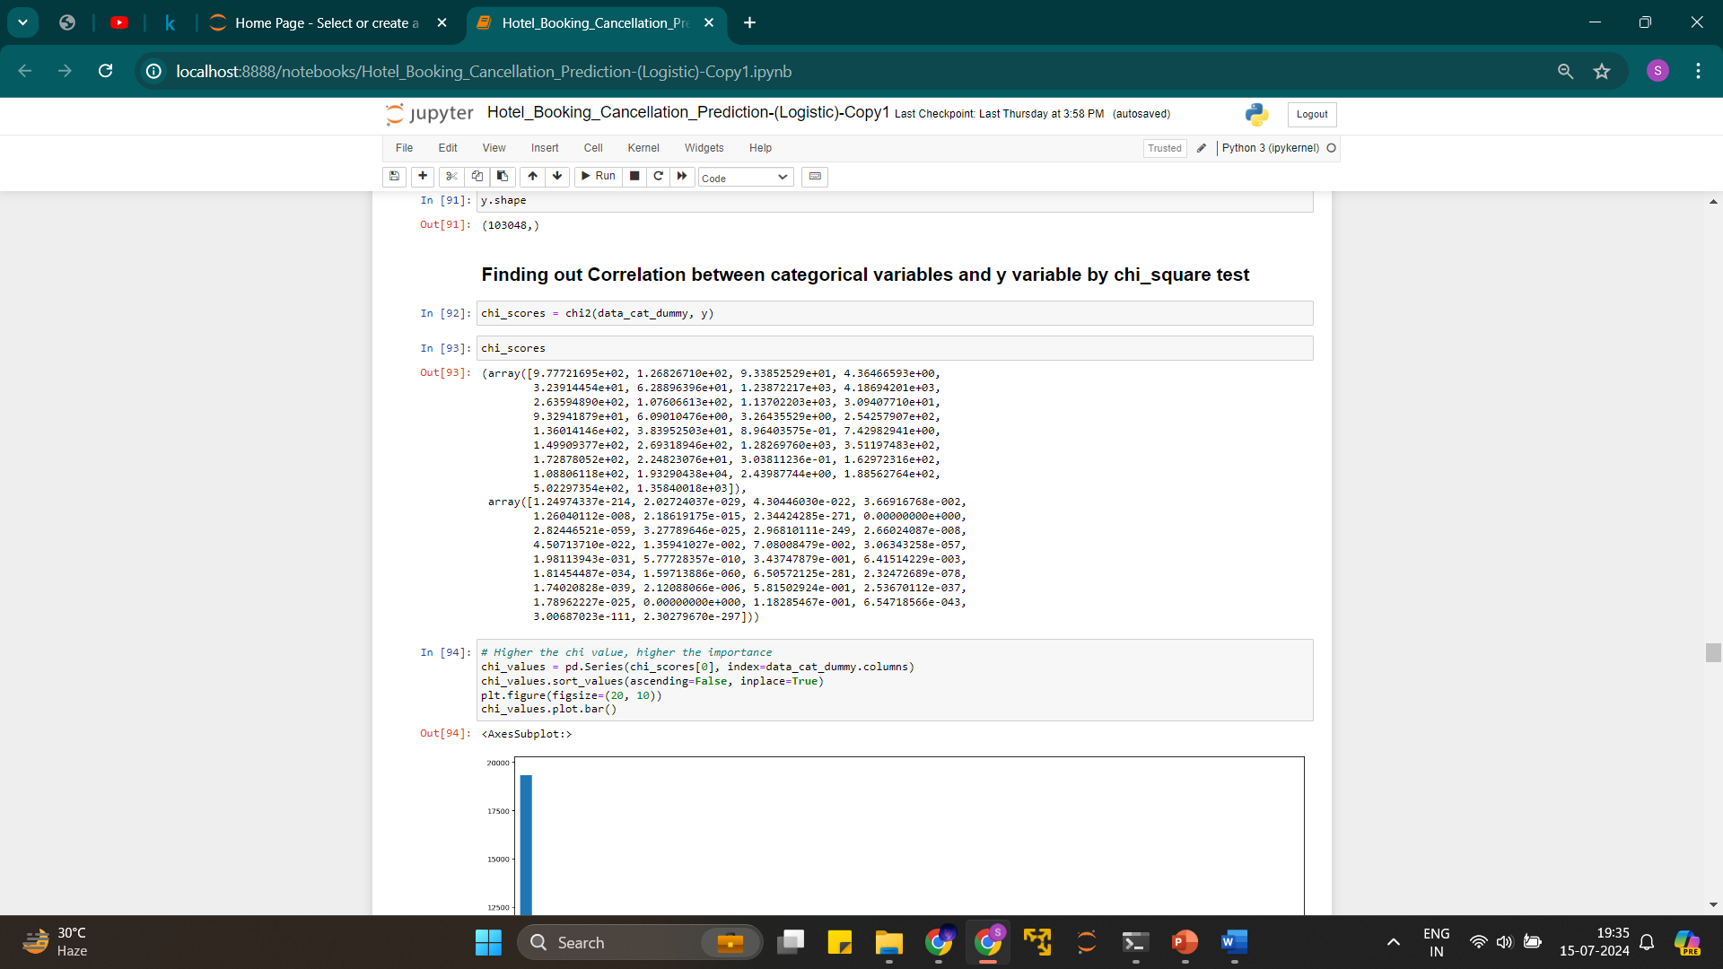

Slide 34
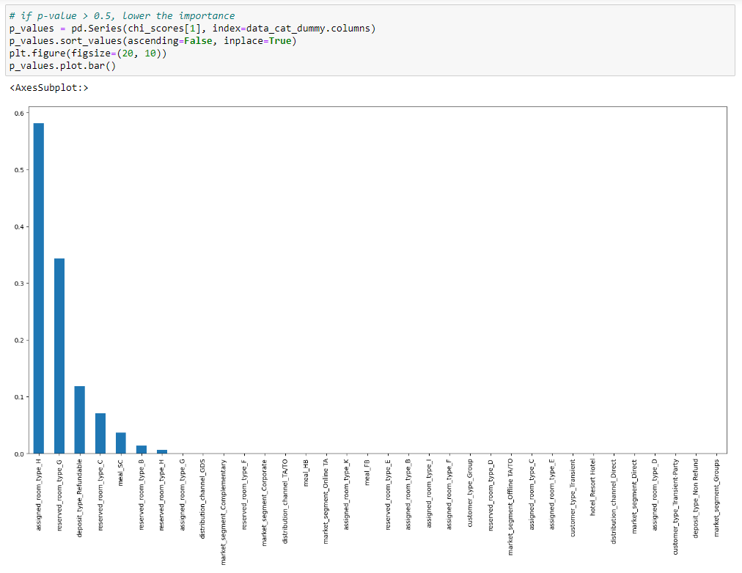

Slide 35
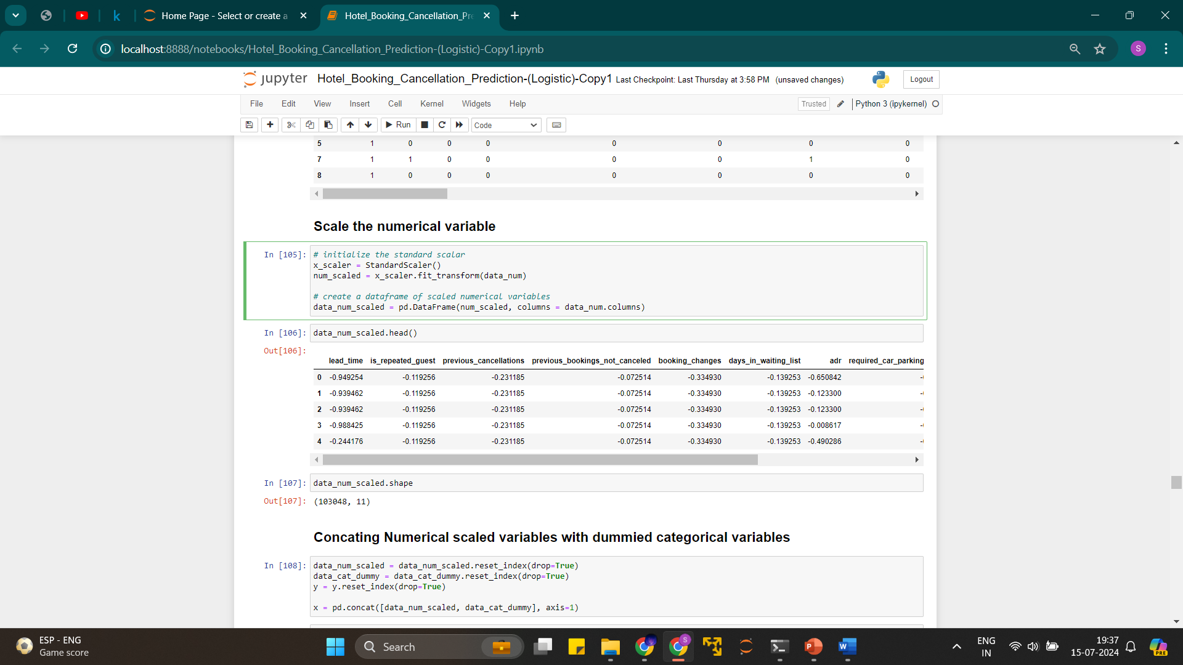
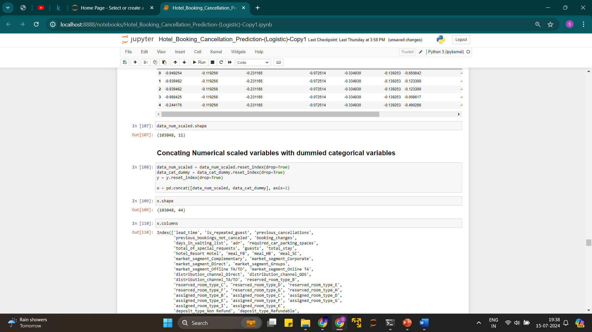
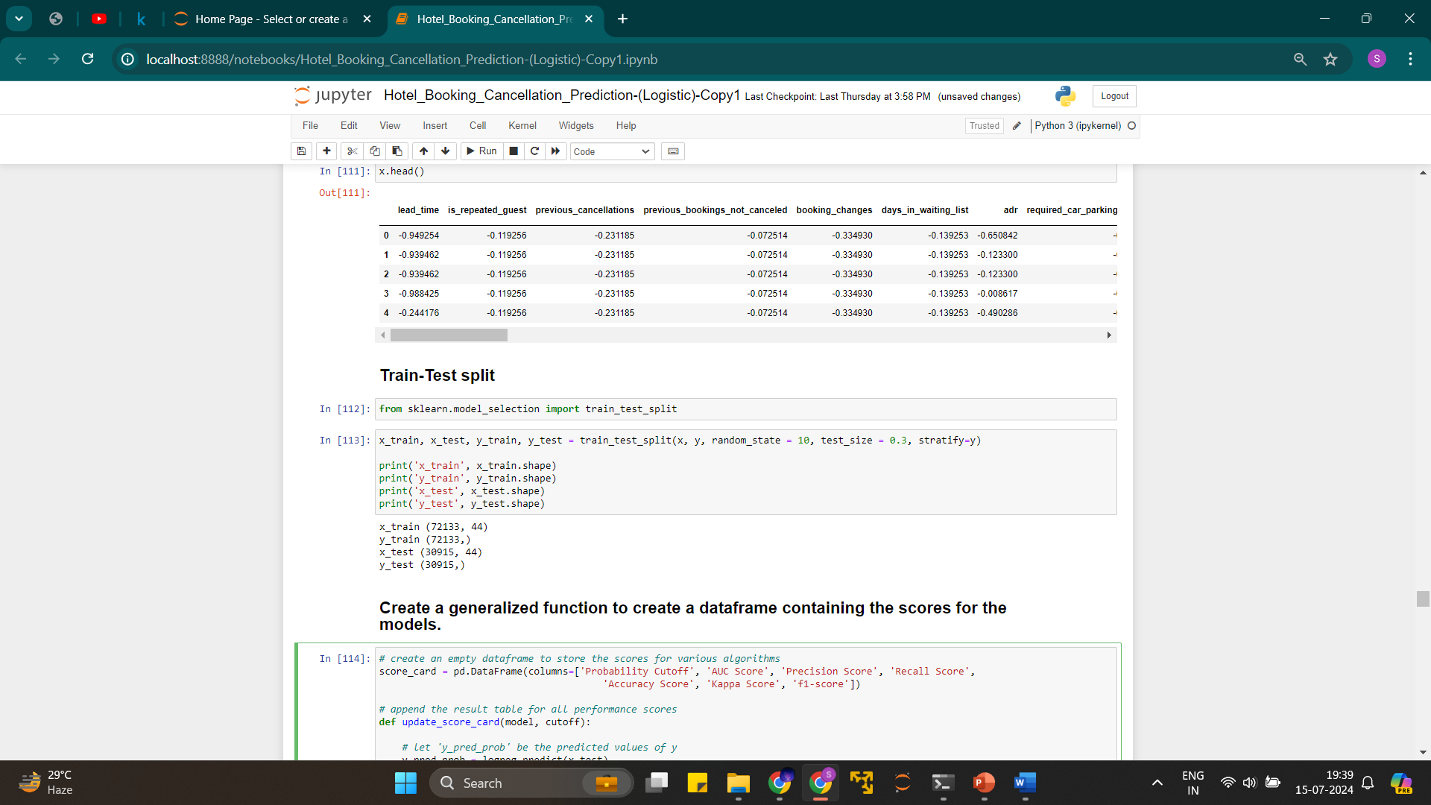

Slide 36
Data Modelling

Slide 37
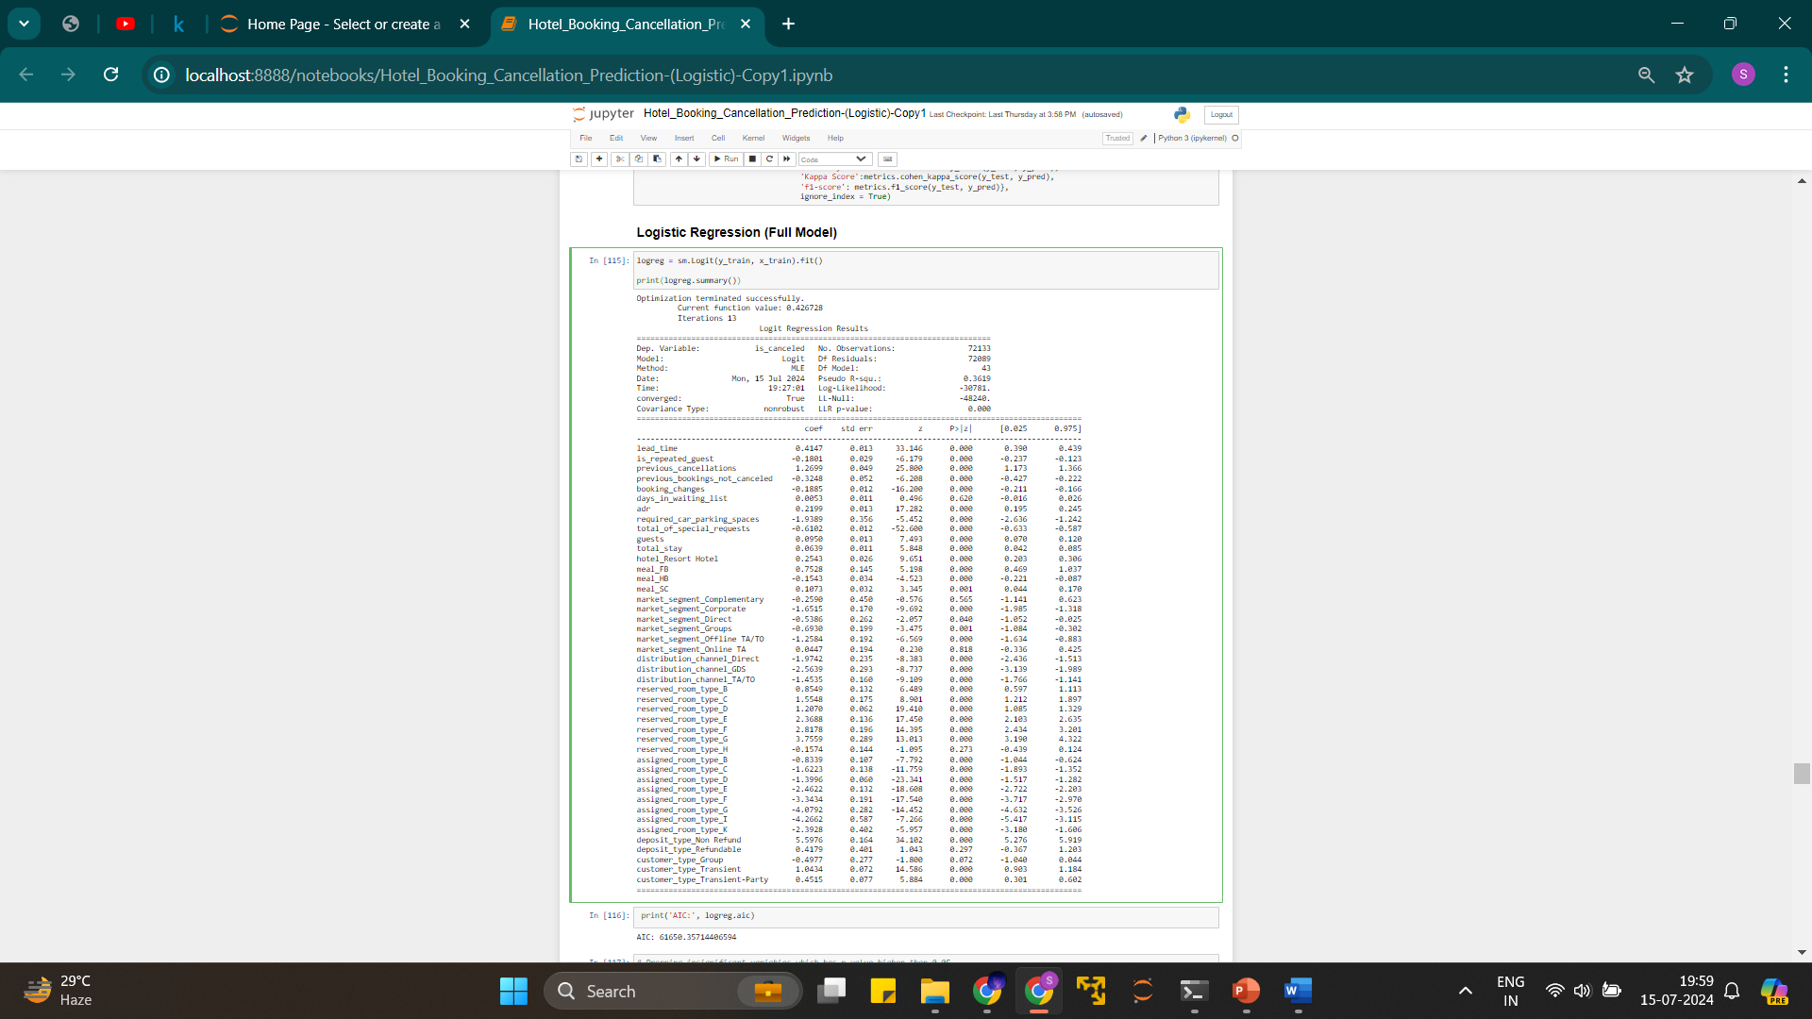

Slide 38
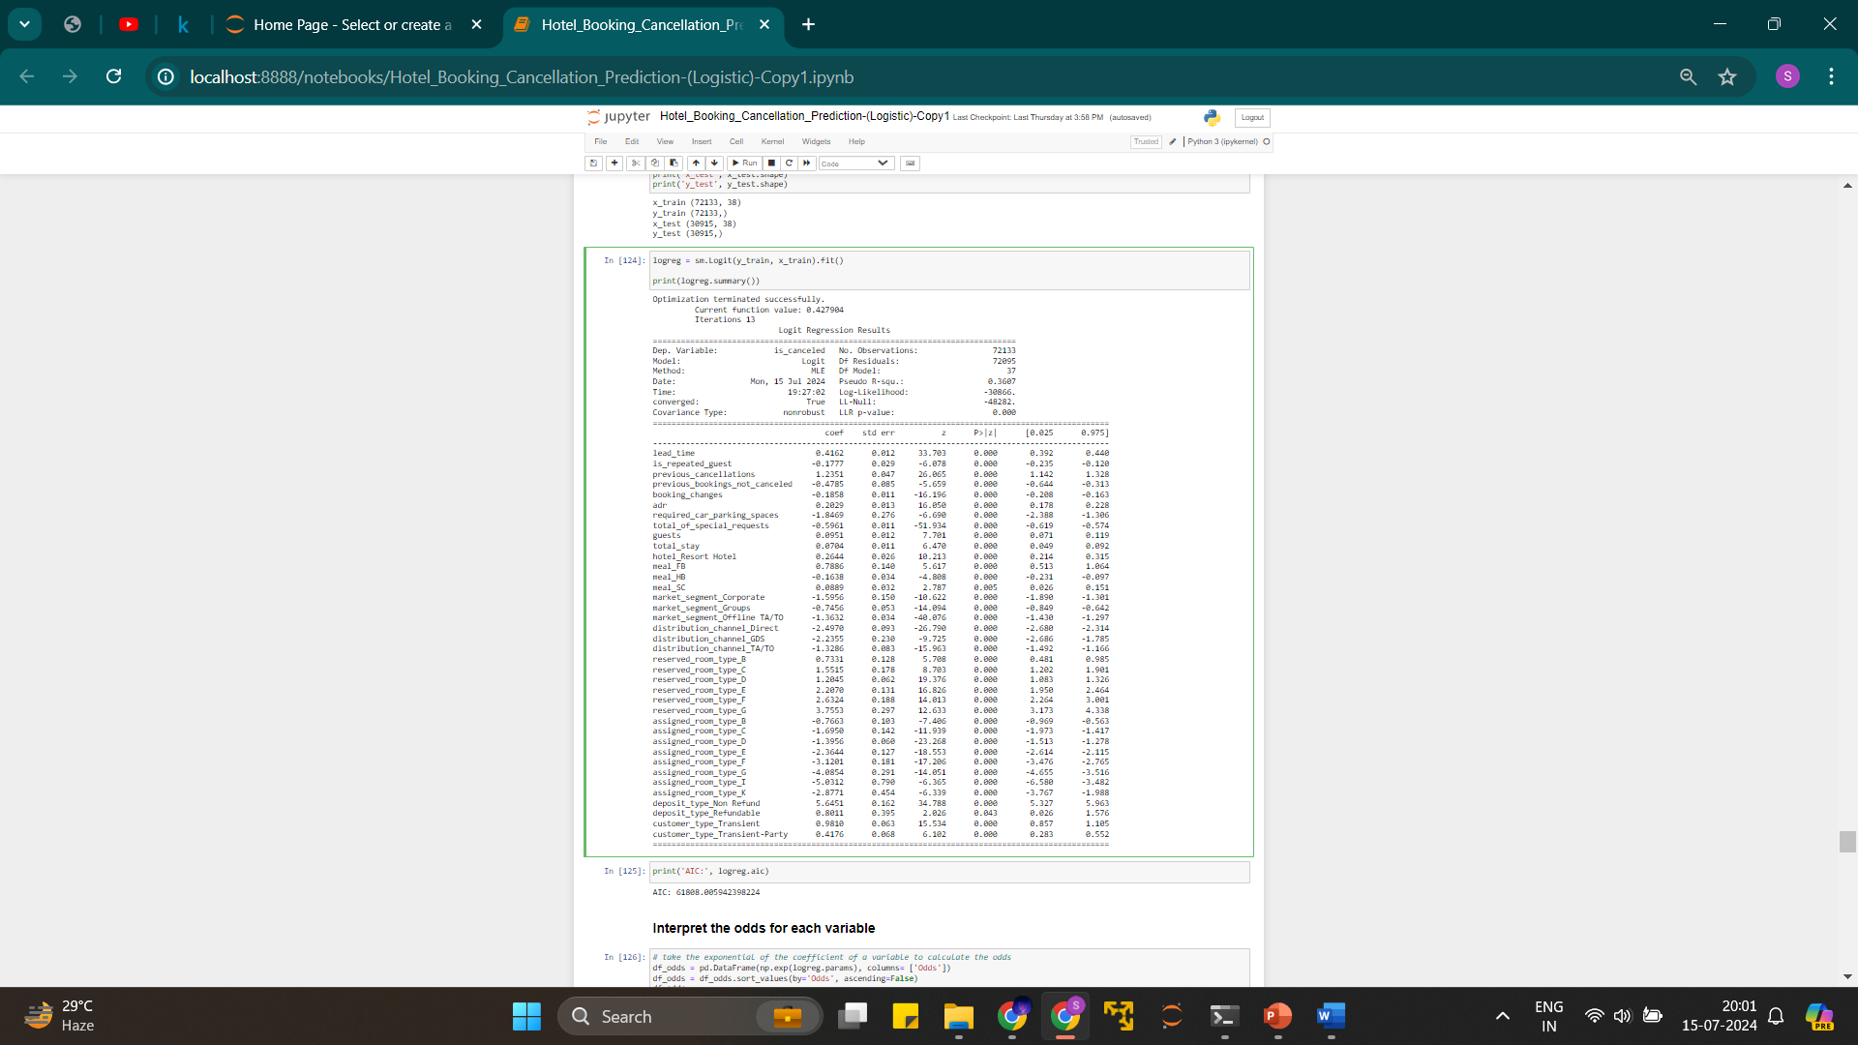

Slide 39
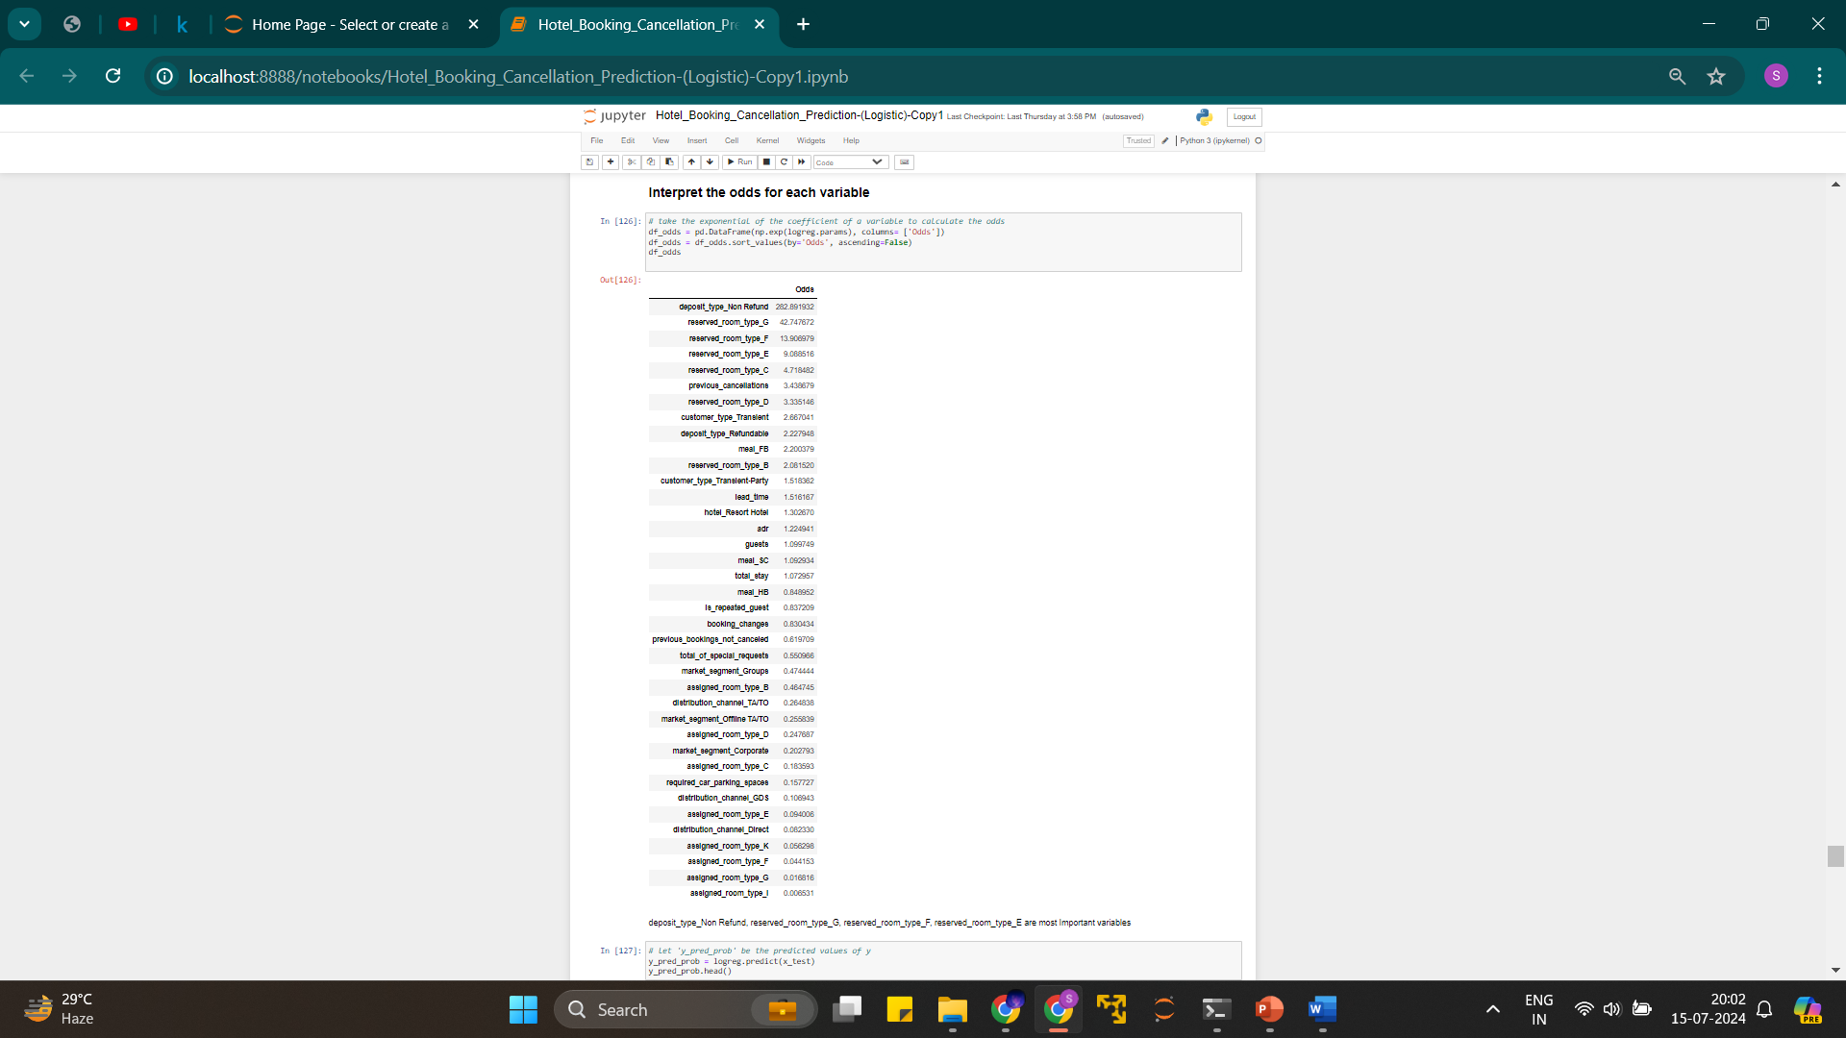
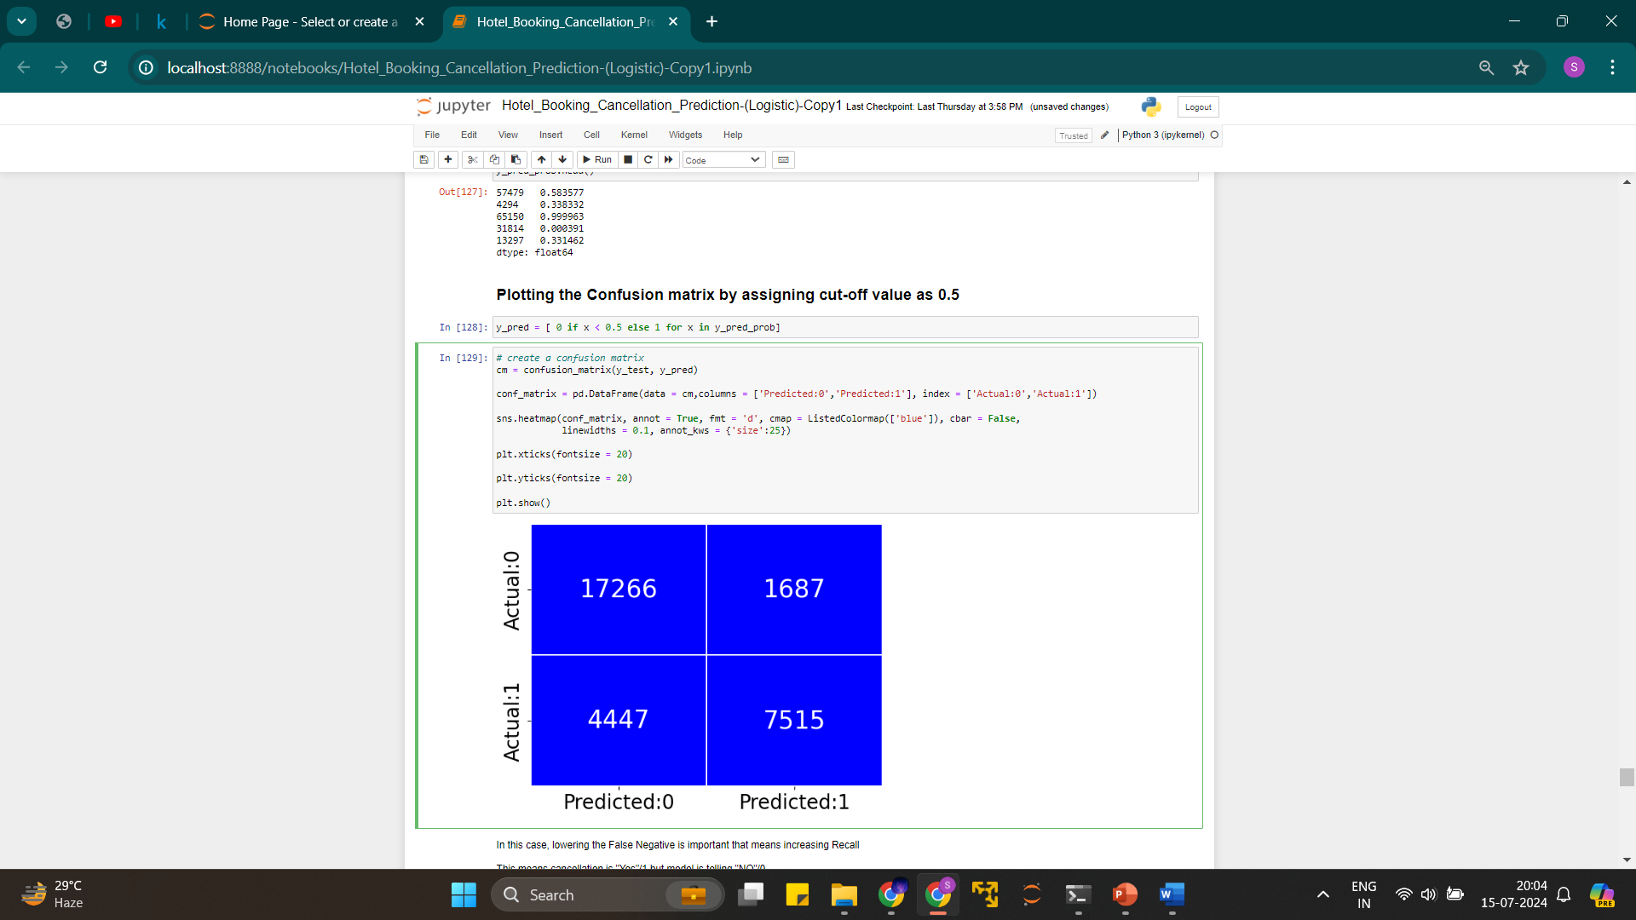
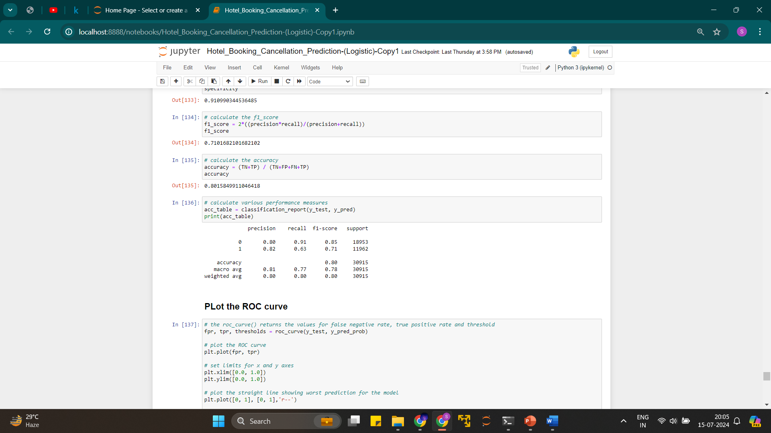

Slide 40
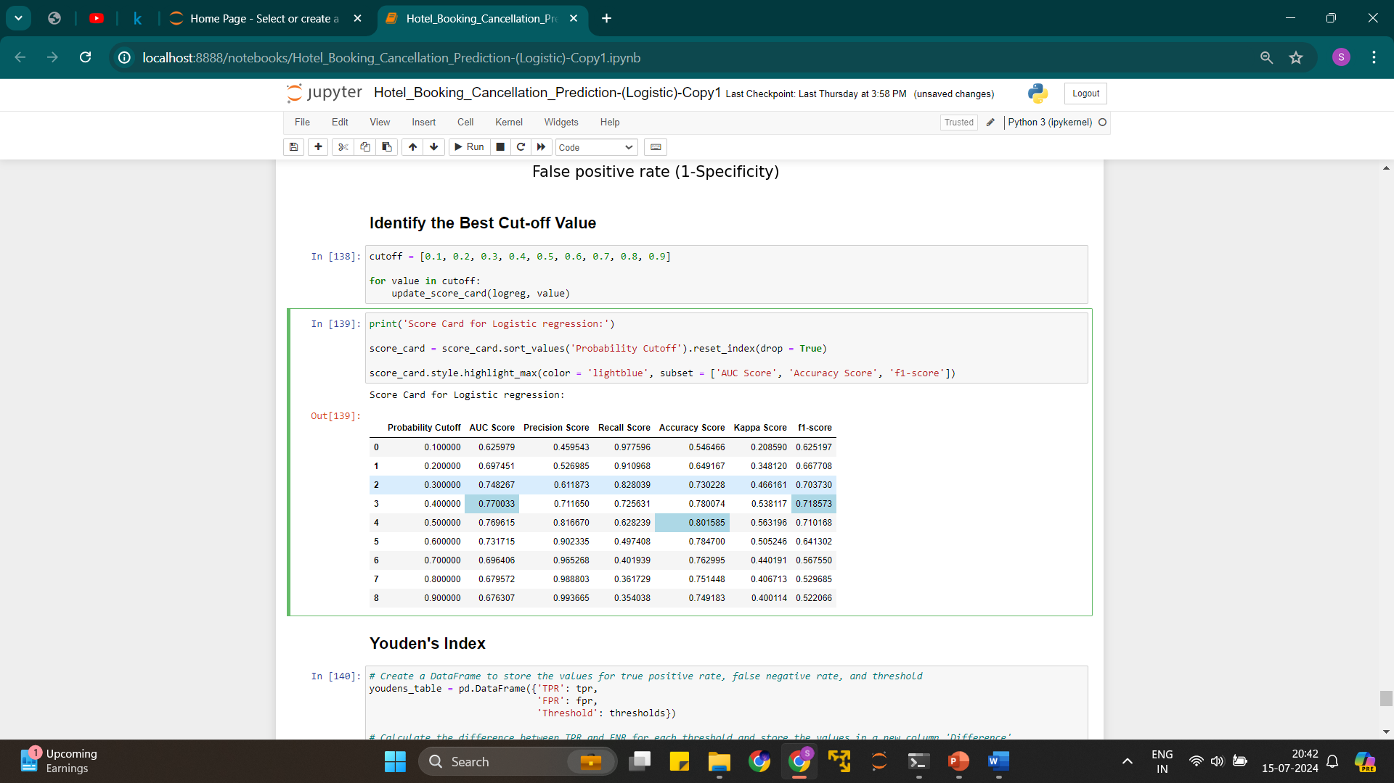
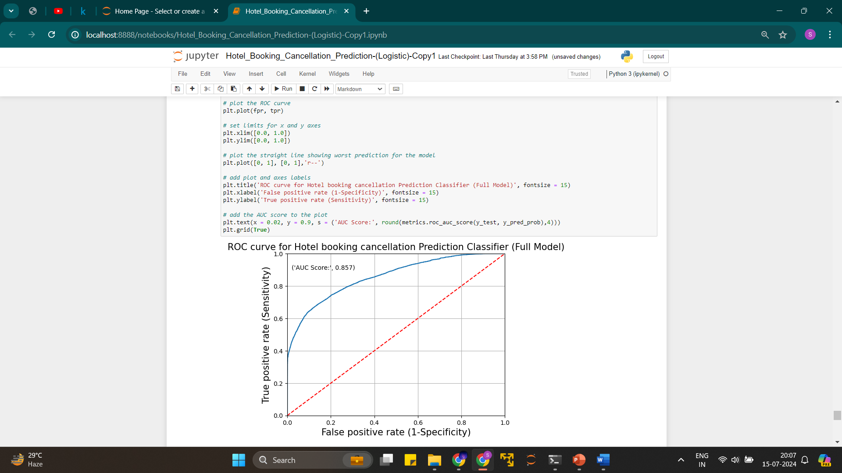

Slide 41
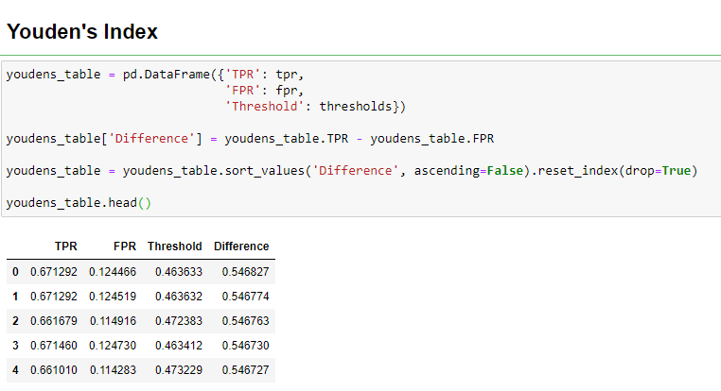

Slide 42
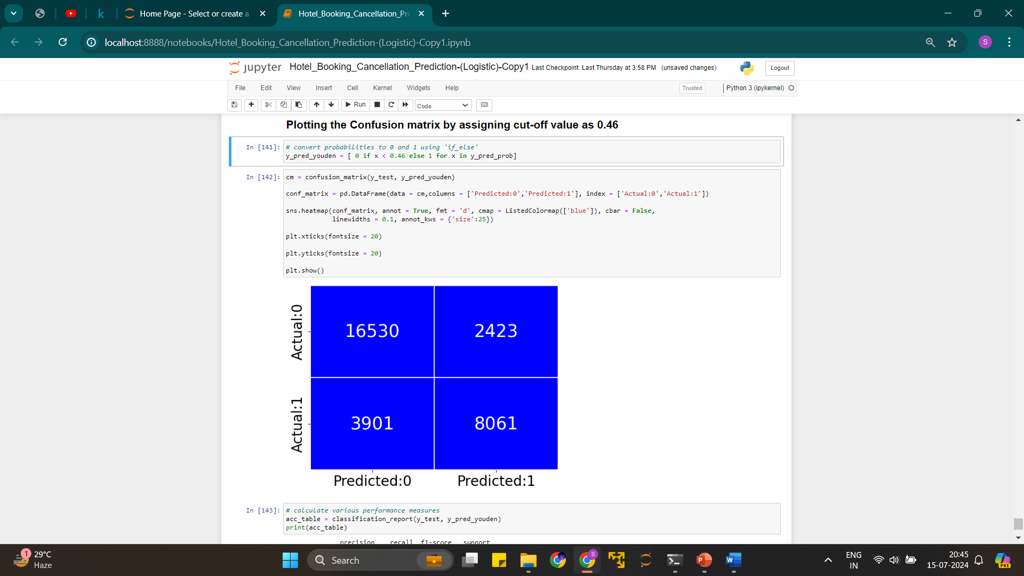
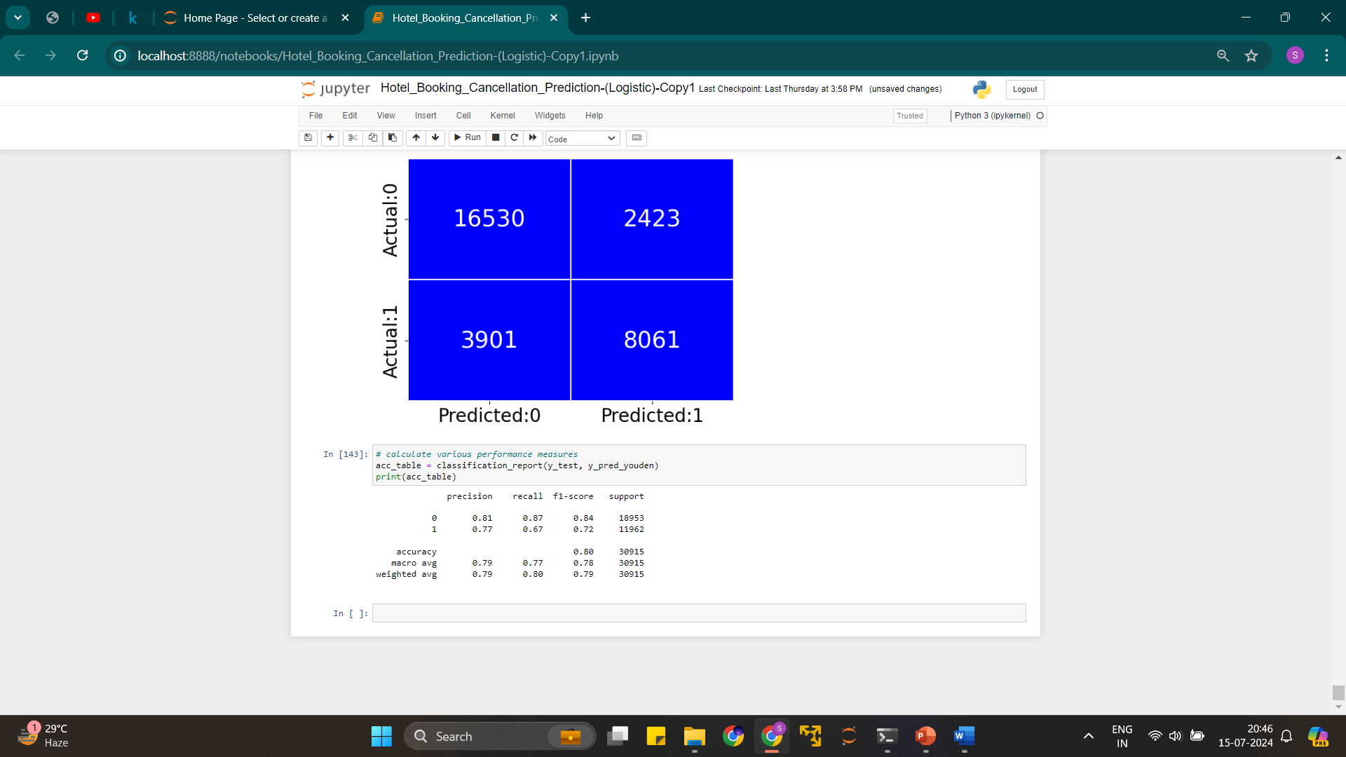

Slide 43



Slide 44



Slide 45



Slide 46



Slide 47



Slide 48



Slide 49



Slide 50


Slide 51



Slide 52



Slide 53



Slide 54



Slide 55



Slide 56



Slide 57


Slide 58


Slide 59
Suggestions -
1. Cancellation rates rise as the price does. To prevent cancellations of reservations, hotels could work on them
pricing strategies and try to lower the rates for specific hotels based on locations. They Can also provide some discounts
to the consumers.
2. As the ratio of the cancellation and not cancellation of the resort hotel is higher in the resort hotel than the city
hotels. so, the hotels should provide a reasonable discount on the room prices on weekends or on holidays.
3. In the month of January, hotels can start campaigns or marketing with a reasonable amount to increase their revenue as the
cancellation is the highest in this month.
4. They can also increase the quality of the hotels and their services mainly in Portugal to reduce the cancellation rate

Slide 60
Conclusion
1. Factors Influencing Cancellations:
- Lead Time: Longer lead times are associated with higher cancellation rates.
- Deposit Policy: Non-refundable deposits significantly reduce cancellations.
- Special Requests: Guests making more special requests are less likely to cancel.
- Repeat Guests: Repeat guests have lower cancellation rates, highlighting the importance of customer loyalty
2. Model Performance:
- Regularized models and tree-based models (like XGBoost) perform well even with outliers present in the data.
- XGBoost was identified as the best model for predicting cancellations, achieving a balanced accuracy score of 88.69%.
- The model correctly classified 85% of users who cancelled and 91% who did not
3. Model Deployment:
- The model was successfully deployed using Pickle files in a Jupyter Notebook and Streamlit environment, facilitating practical application and usability by hotel management
4. Actionable Insights for Hotels:
- By leveraging the predictive model, hotels can identify bookings at higher risk of cancellation and implement measures to mitigate these risks,
such as imposing higher cancellation fees on such bookings.
- The analysis suggests pricing strategies and targeted discounts to reduce cancellation rates,
particularly during high-risk periods (e.g., January) and for certain hotel types (e.g., resort hotels)
5. Suggestions for Improvement:
- Adjust pricing strategies to lower rates for specific hotels based on location and time, potentially offering discounts to decrease cancellation rates.
- Enhance hotel quality and services, especially in locations with higher cancellation rates, like Portugal, to improve customer satisfaction and reduce cancellations
Overall, the project emphasizes the importance of understanding the factors that influence hotel booking cancellations and using predictive
models to improve revenue management and operational planning in the hospitality industry.

